Slide 1
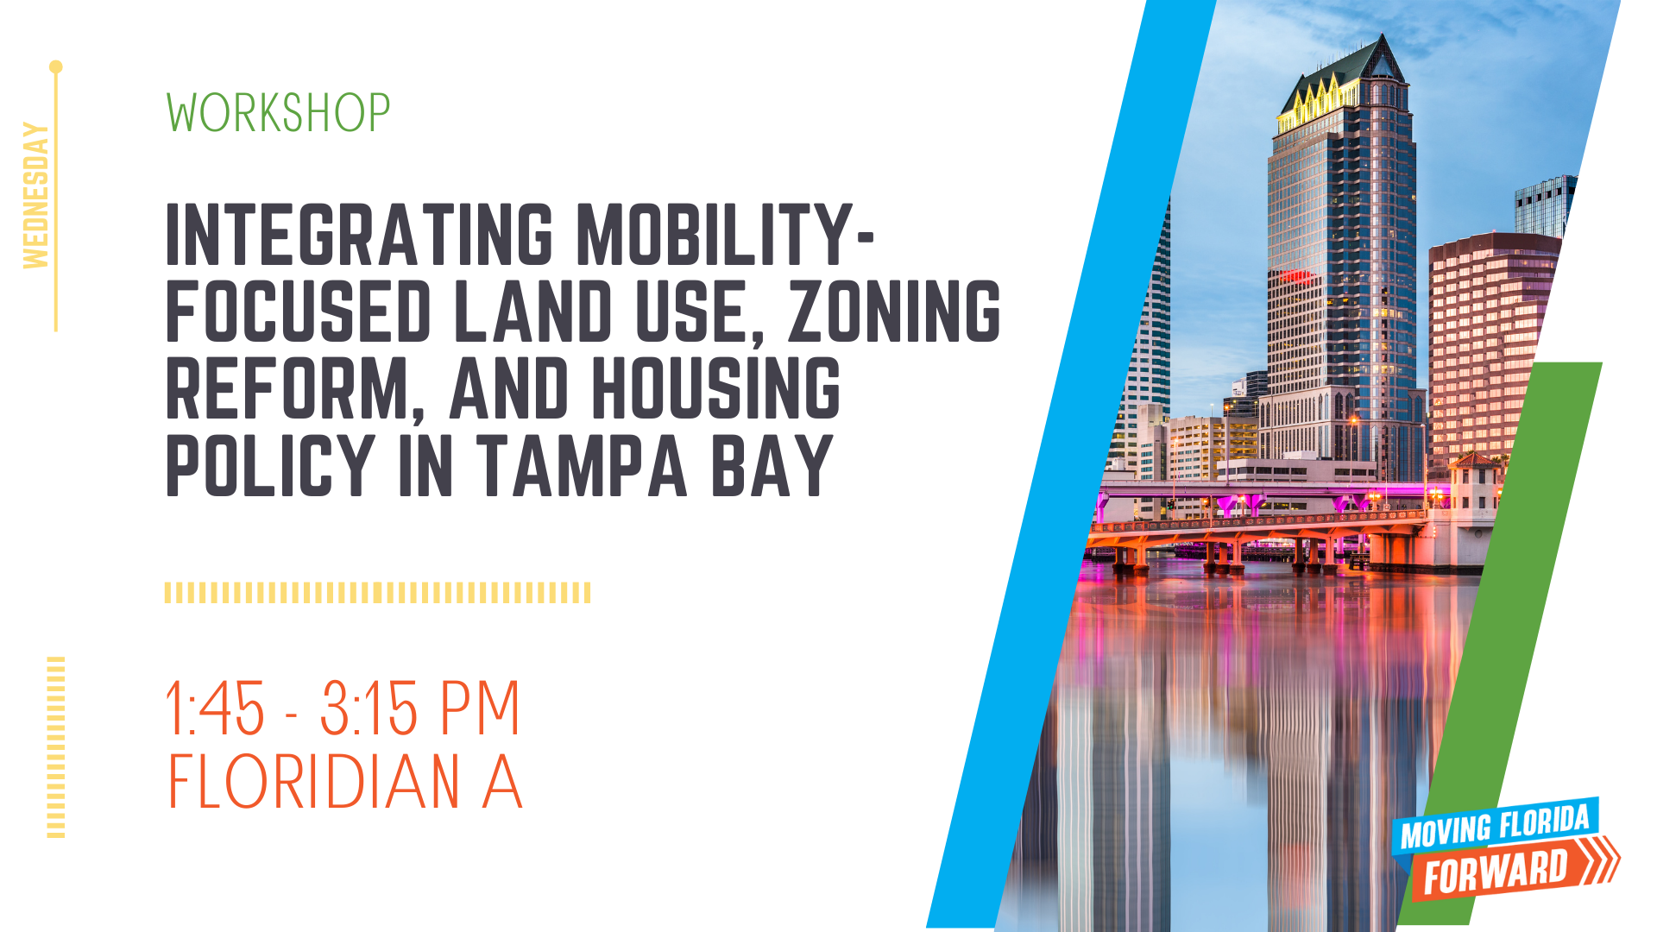

Slide 2


Slide 3
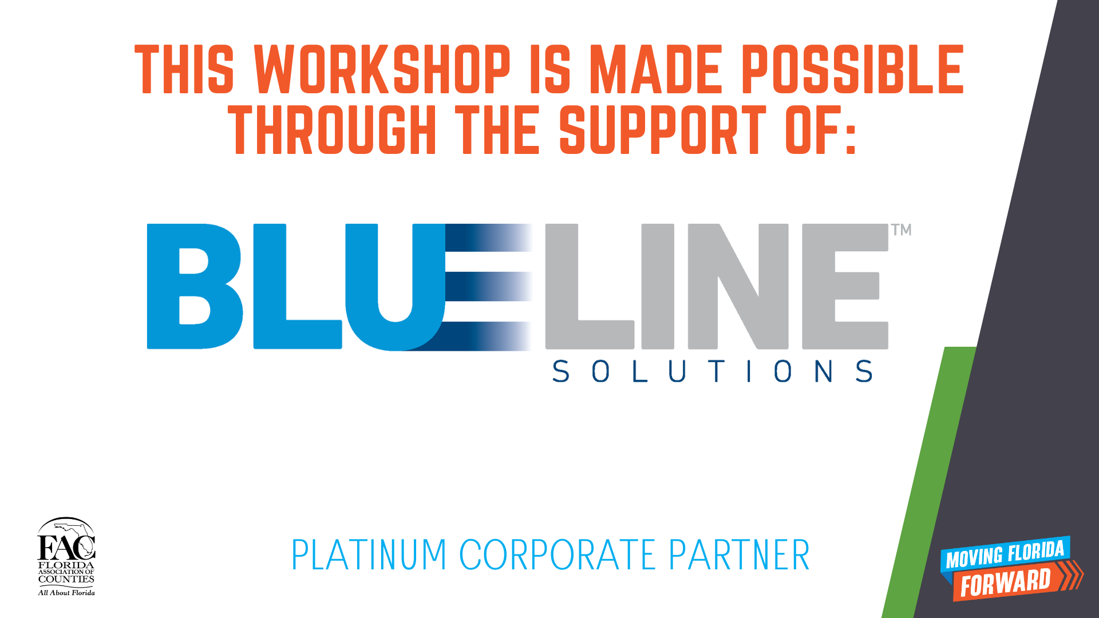

Slide 4
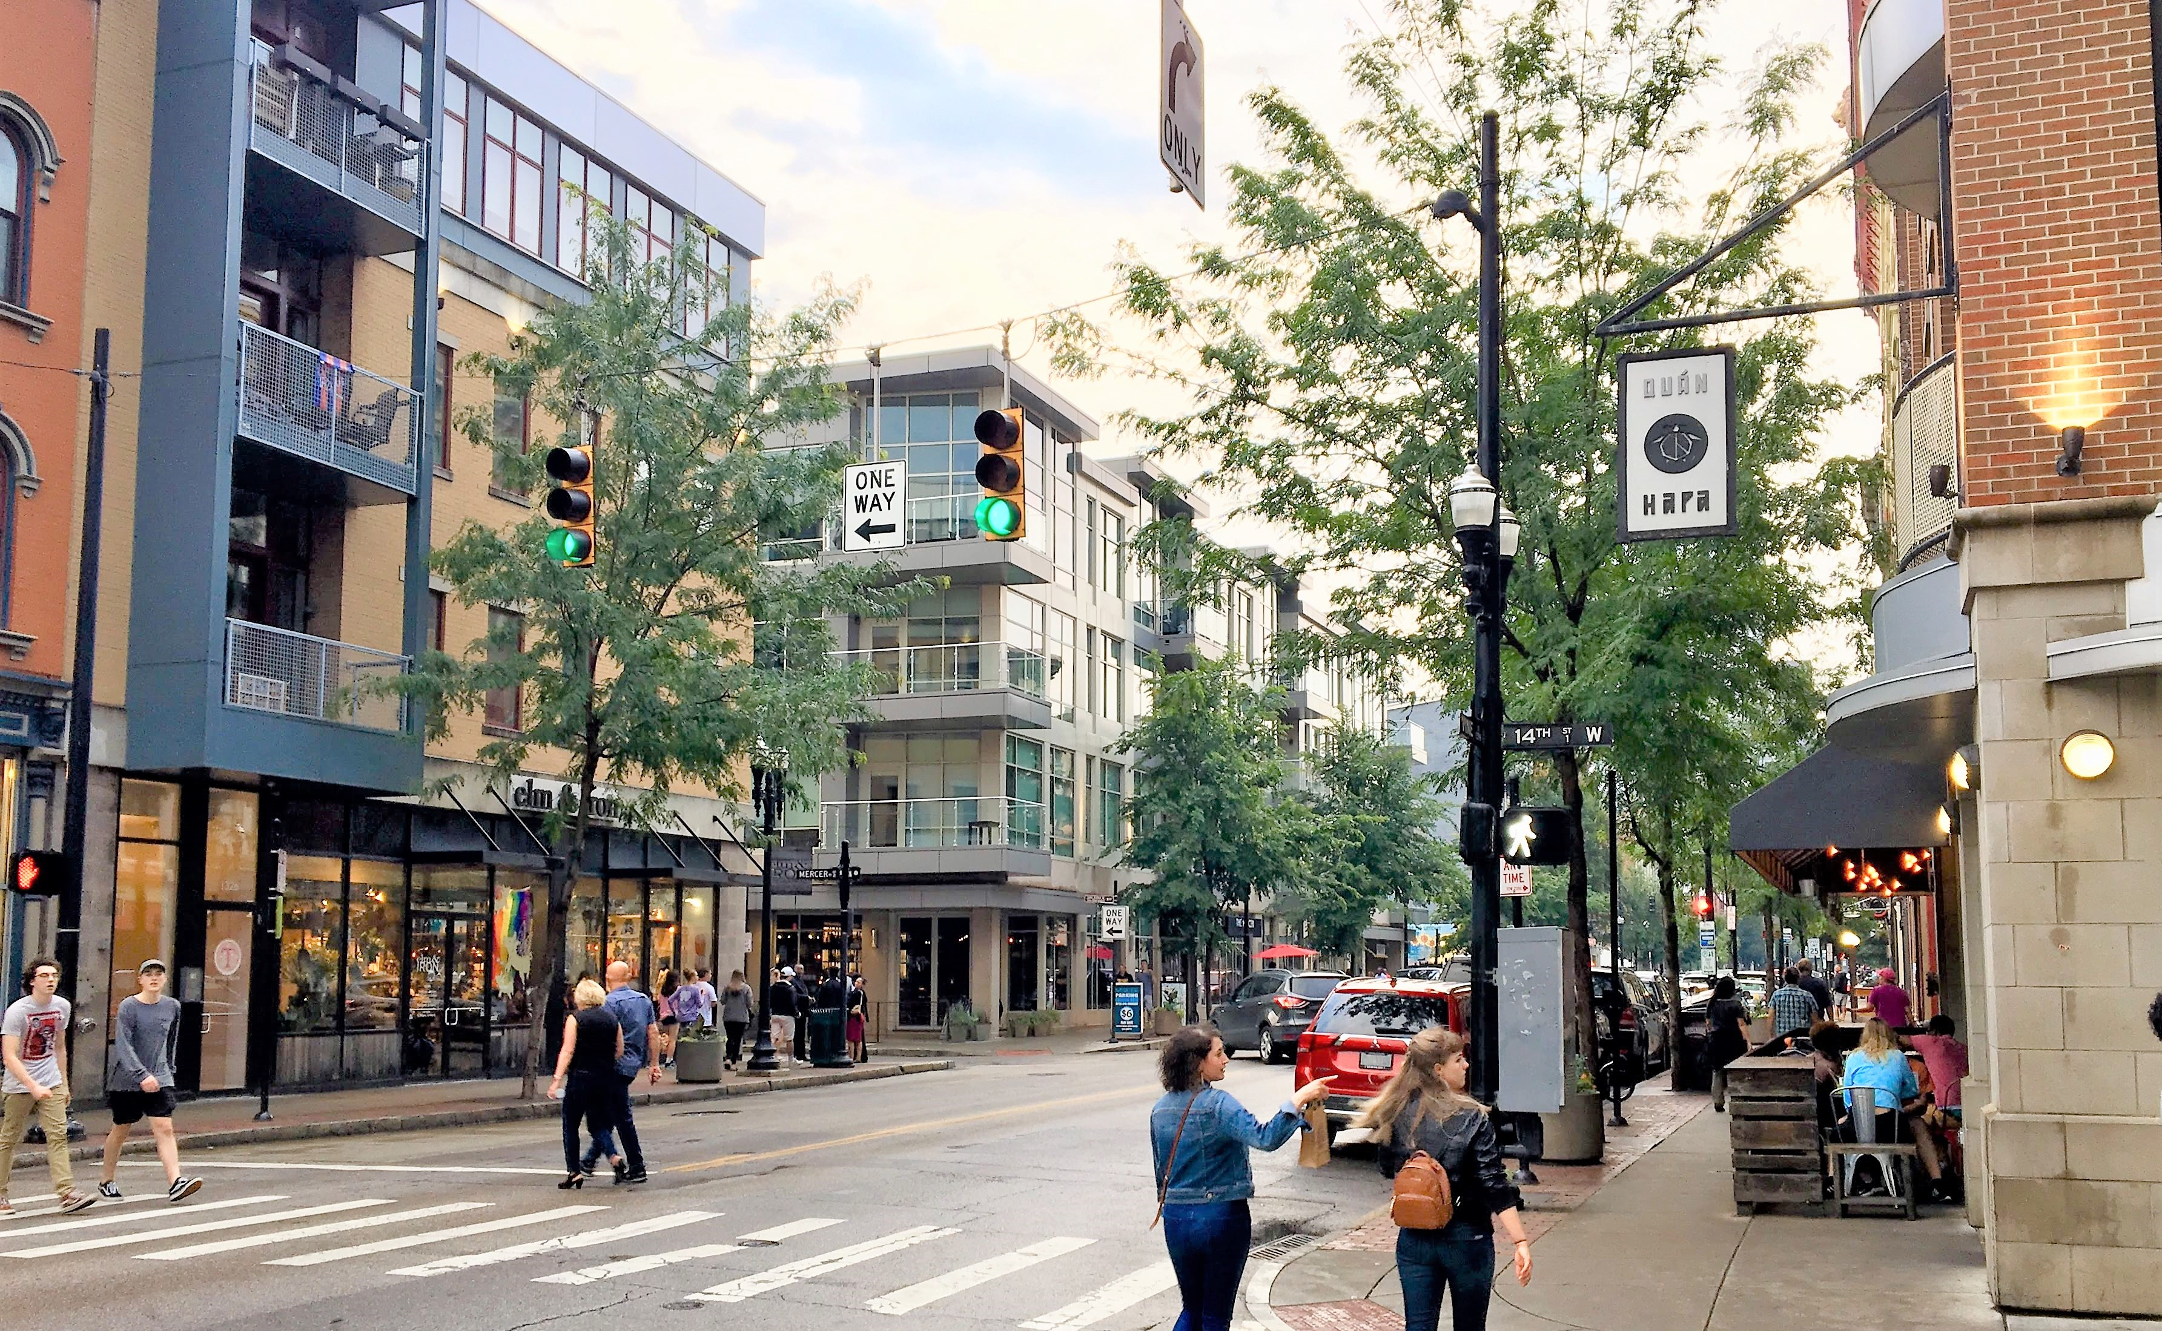
CODING FOR COMMUNITY
Resilience | Diversity | Affordability | Transit-Supportiveness | Walkability

Slide 5
ADVANCING COMMON GOALS
Transit-Supportiveness & Walkability
Align land use and mobility planning to create more connected forms of development. Promote transit and active transportation as attractive and realistic alternatives to driving.
Affordability & Diversity
Recalibrate codes to meet changing demand. Incentivize affordable housing and a wider diversity of housing types.
Sustainability & Resilience
Promote projects that deliver sustainable resultts, reduce fiscal stress, conserve energy, improve public health outcomes, and reduce VMT & GHG emissions.

Slide 6
DRIVERS SHAPING PROJECTS
POLICY & CODE DEVELOPMENT
Use, Form, Diversity, & Affordability
Financial & Market Feasibility
Building Code & Construction Methods
Site Conditions & Context
Mobility Options

Slide 7
TEST FITS &
FINANCIAL FEASIBILITY

Slide 8
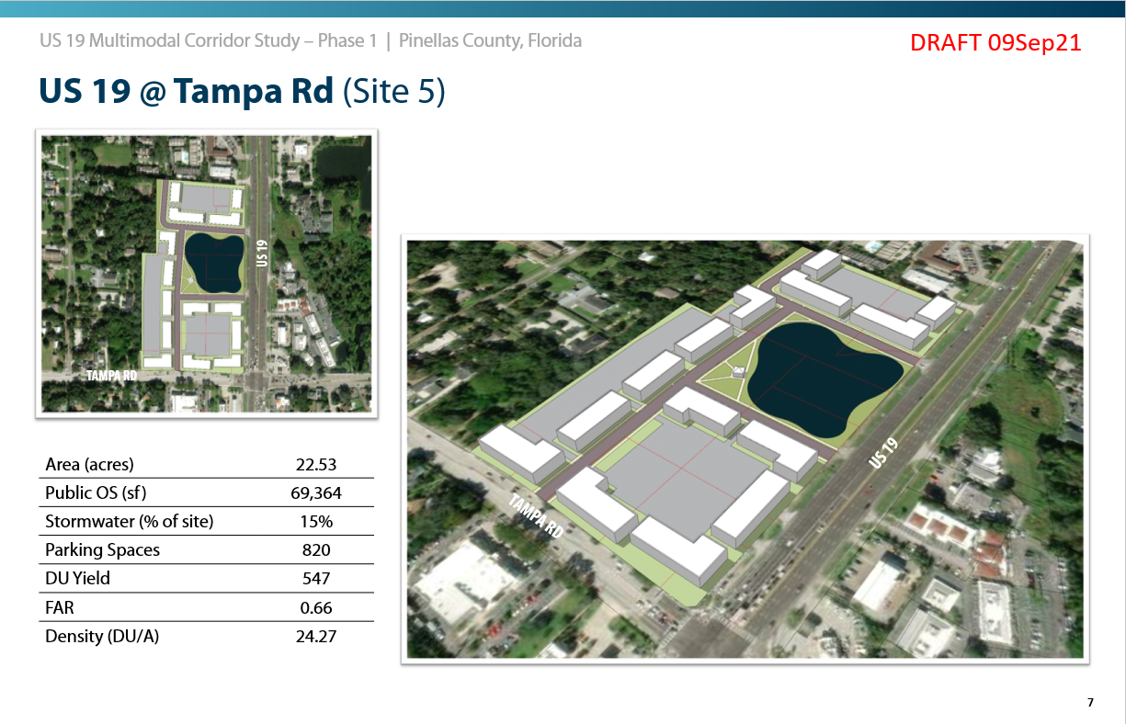
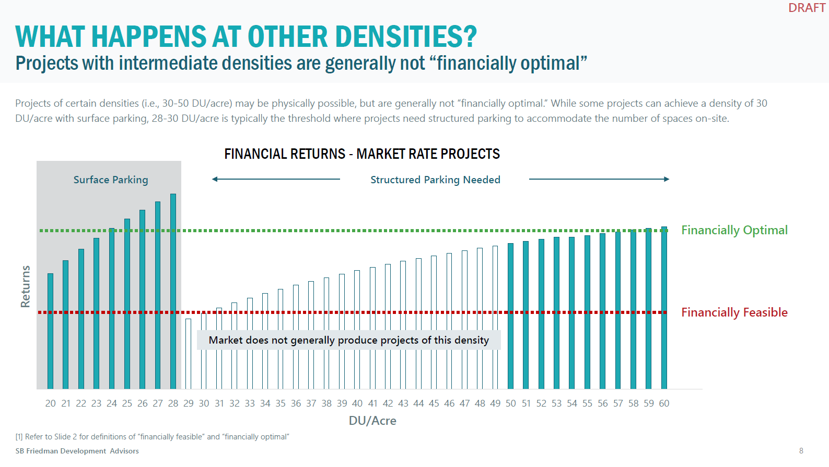
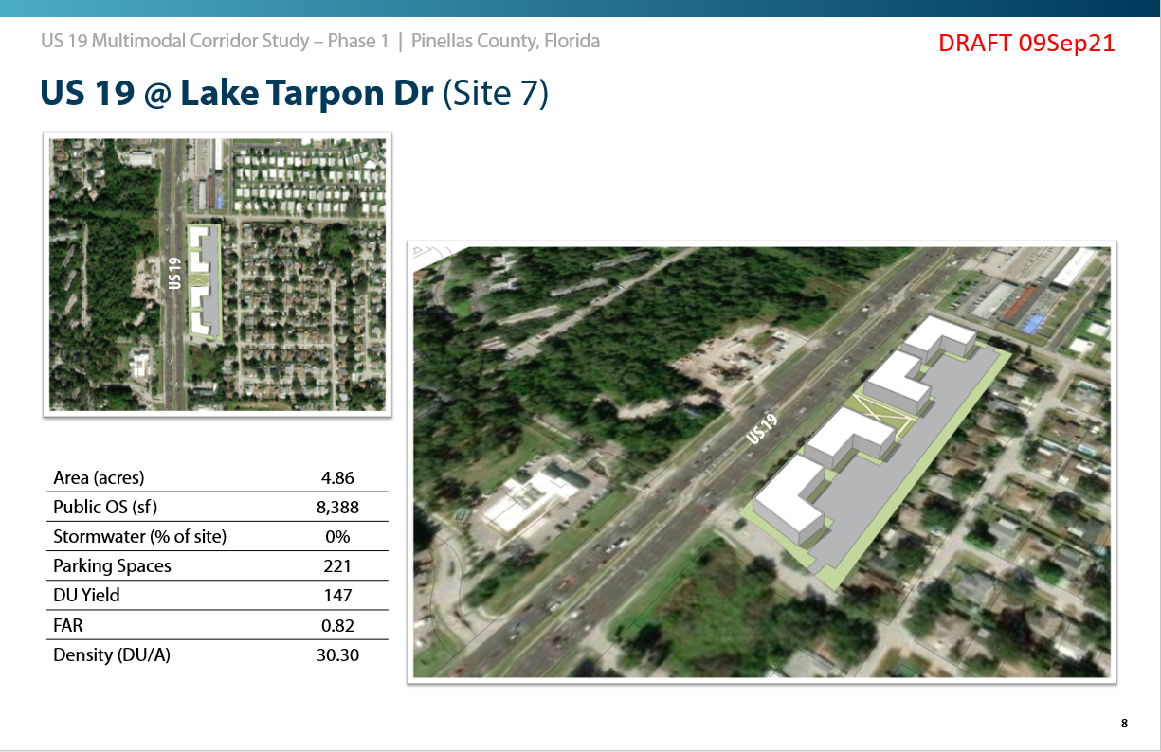
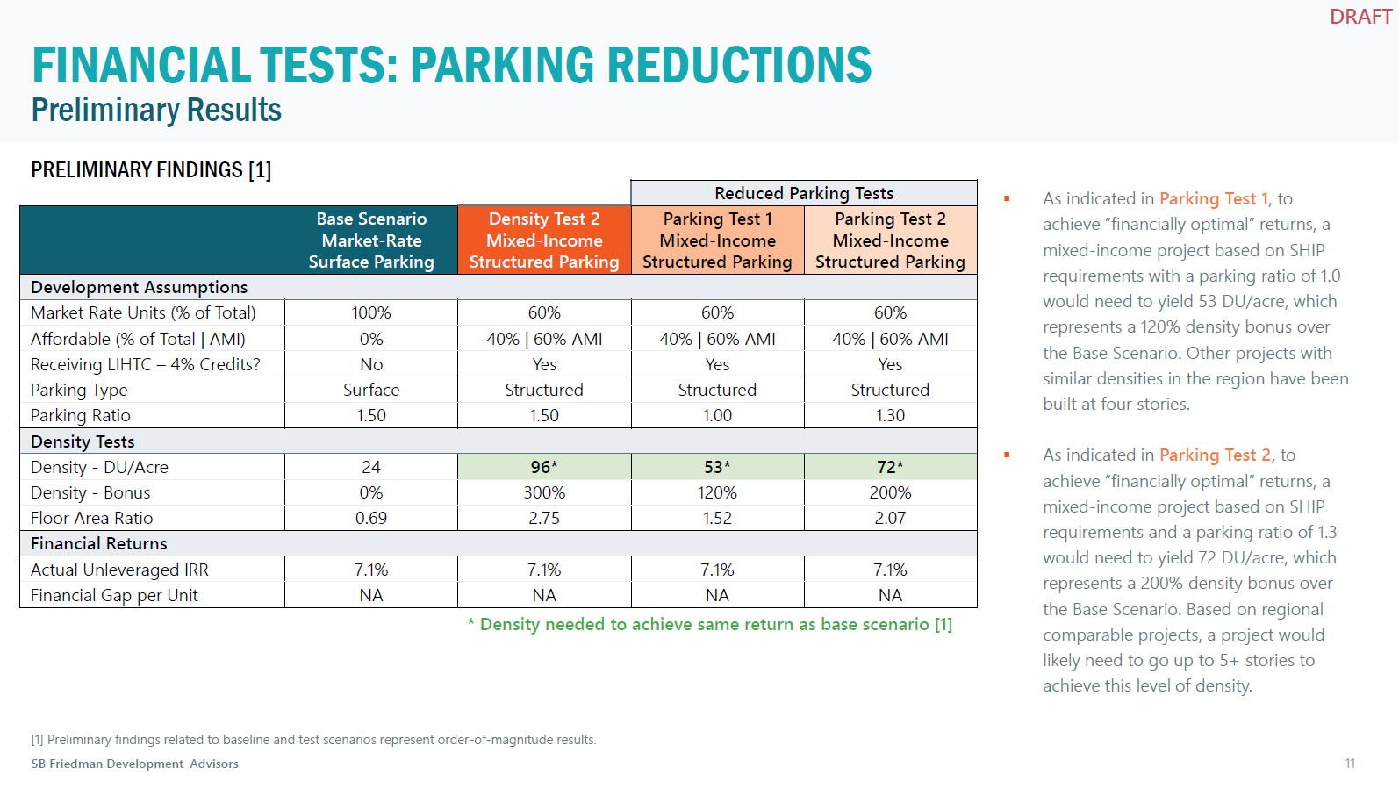
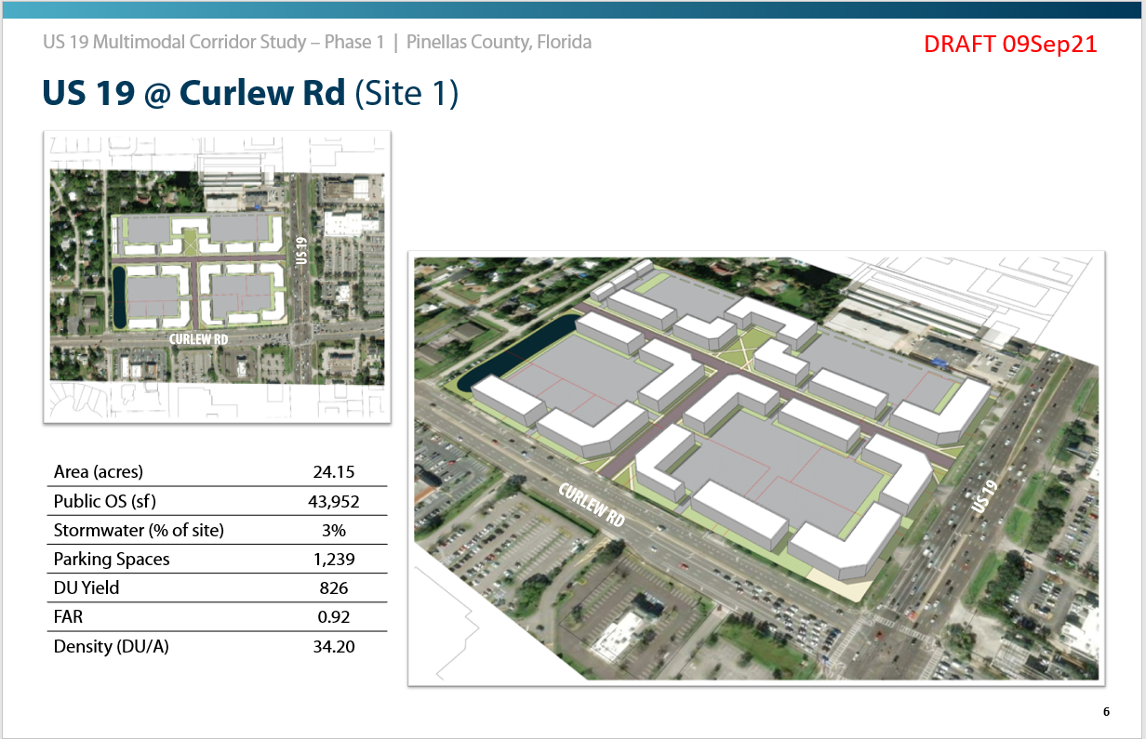
TEST FITS & FINANCIAL FEASIBILITY
Examples from the US19 Multimodal Corridor Study, Pinellas County, Florida
Site Development Studies
Bonus Feasibility Tests
Tests suggested significant density increases and parking reductions required to achieve 40% affordable units at 60% AMI. With ROI held constant, density needed to increase from 24 DU/A to over 90 DU/A due to cost per unit of structured parking.

Slide 9
DEVELOPMENT TYPOLOGY RESEARCH

Slide 10
DEVELOPMENT TYPOLOGY RESEARCH
Recent Research Guides Planning & Coding
Document Scale, Context, Density/Intensity, & Configuration.
Identify Common Characteristics & Outliers
Focus on Multifamily & Multifamily Mixed Use Projects in the Tampa Bay Region Since 2006
Data from property appraiser records supplemented by site plan approval data. Be careful with commercial sources.

Slide 11
PROJECT YIELD & CONFIGURATION
MARKET RATE
AFFORDABLE
6+ STORY MULTIFAMILY
STRUCTURED PARKING
AVERAGES
Units per Project: 318
Density: 183.0 DU/A
Intensity: 5.0 FAR
Site Size: 2.7 ACRES
4-5 STORY MULTIFAMILY
STRUCTURED PARKING
AVERAGES
Units per Project: 353
Density: 80.6 DU/A
Intensity: 2.0 FAR
Site Size: 3.7 ACRES
2-4 STORY MULTIFAMILY
SURFACE PARKING
AVERAGES
Units per Project: 281
Density: 22.0 DU/A
Intensity: 0.5 FAR
Site Size: 12.7 ACRES
ATTACHED SINGLE FAMILY & SF+ADU
AVERAGES
Units per Project: 6
Density: 17.1 DU/A
Intensity: 2.1 FAR
Site Size: 0.3 ACRES
AFFORDABLE
MULTIFAMILY
AVERAGES
Units per Project: 107
Density: 43.4 DU/A
Intensity: 1.1 FAR
Site Size: 4.1 ACRES
DWELLING UNITS PER ACRE
DWELLING UNITS PER ACRE
*
*
DU/A RANGE
362-206
172-59 DU/A
120-51 DU/A
31-15 DU/A
33-12 DU/A
105-40
29-13 DU/A
Stories
10+ Stories
6-10 Stories
4-5 Stories
2-4 Stories
2-3 Stories
5-7
2-4 Stories
PARKING
Structured
Surface
Structured
Surface
*Projects without structured parking but with reduced parking and supported by a mix of surface parking types, including tuck under, on-street, and alley-accessed.

Slide 12
PROJECT YIELD & CONFIGURATION
MARKET RATE
AFFORDABLE
UNCOMMON TYPES
6+ STORY MULTIFAMILY
STRUCTURED PARKING
AVERAGES
Units per Project: 318
Density: 183.0 DU/A
Intensity: 5.0 FAR
Site Size: 2.7 ACRES
4-5 STORY MULTIFAMILY
STRUCTURED PARKING
AVERAGES
Units per Project: 353
Density: 80.6 DU/A
Intensity: 2.0 FAR
Site Size: 3.7 ACRES
2-4 STORY MULTIFAMILY
SURFACE PARKING
AVERAGES
Units per Project: 281
Density: 22.0 DU/A
Intensity: 0.5 FAR
Site Size: 12.7 ACRES
ATTACHED SINGLE FAMILY & SF+ADU
AVERAGES
Units per Project: 6
Density: 17.1 DU/A
Intensity: 2.1 FAR
Site Size: 0.3 ACRES
AFFORDABLE
MULTIFAMILY
AVERAGES
Units per Project: 107
Density: 43.4 DU/A
Intensity: 1.1 FAR
Site Size: 4.1 ACRES
Shaped by a very unique sets of conditions. Virtually all receive significant parking reductions and various combinations of financial support.
DWELLING UNITS PER ACRE
DWELLING UNITS PER ACRE
Projects in downtown and downtown-adjacent locations. Towers above parking podiums, often with active ground floor space. Rare but highly land efficient and typically deliver quality frontage conditions.
*
*
DU/A RANGE
362-206
172-59 DU/A
120-51 DU/A
31-15 DU/A
33-12 DU/A
105-40
29-13 DU/A
Stories
10+ Stories
6-10 Stories
4-5 Stories
2-4 Stories
2-3 Stories
5-7
2-4 Stories
PARKING
Structured
Surface
Structured
Surface
*Projects without structured parking but with reduced parking and supported by a mix of surface parking types, including tuck under, on-street, and alley-accessed.

Slide 13
PROJECT YIELD & CONFIGURATION
MARKET RATE
AFFORDABLE
COMMON TYPES
6+ STORY MULTIFAMILY
STRUCTURED PARKING
AVERAGES
Units per Project: 318
Density: 183.0 DU/A
Intensity: 5.0 FAR
Site Size: 2.7 ACRES
4-5 STORY MULTIFAMILY
STRUCTURED PARKING
AVERAGES
Units per Project: 353
Density: 80.6 DU/A
Intensity: 2.0 FAR
Site Size: 3.7 ACRES
2-4 STORY MULTIFAMILY
SURFACE PARKING
AVERAGES
Units per Project: 281
Density: 22.0 DU/A
Intensity: 0.5 FAR
Site Size: 12.7 ACRES
ATTACHED SINGLE FAMILY & SF+ADU
AVERAGES
Units per Project: 6
Density: 17.1 DU/A
Intensity: 2.1 FAR
Site Size: 0.3 ACRES
AFFORDABLE
MULTIFAMILY
AVERAGES
Units per Project: 107
Density: 43.4 DU/A
Intensity: 1.1 FAR
Site Size: 4.1 ACRES
Texas
Donuts
Suburban
Apartments
Missing Middle
DWELLING UNITS PER ACRE
DWELLING UNITS PER ACRE
*
*
DU/A RANGE
362-206
172-59 DU/A
120-51 DU/A
31-15 DU/A
33-12 DU/A
105-40
29-13 DU/A
Stories
10+ Stories
6-10 Stories
4-5 Stories
2-4 Stories
2-3 Stories
5-7
2-4 Stories
PARKING
Structured
Surface
Structured
Surface

Slide 14
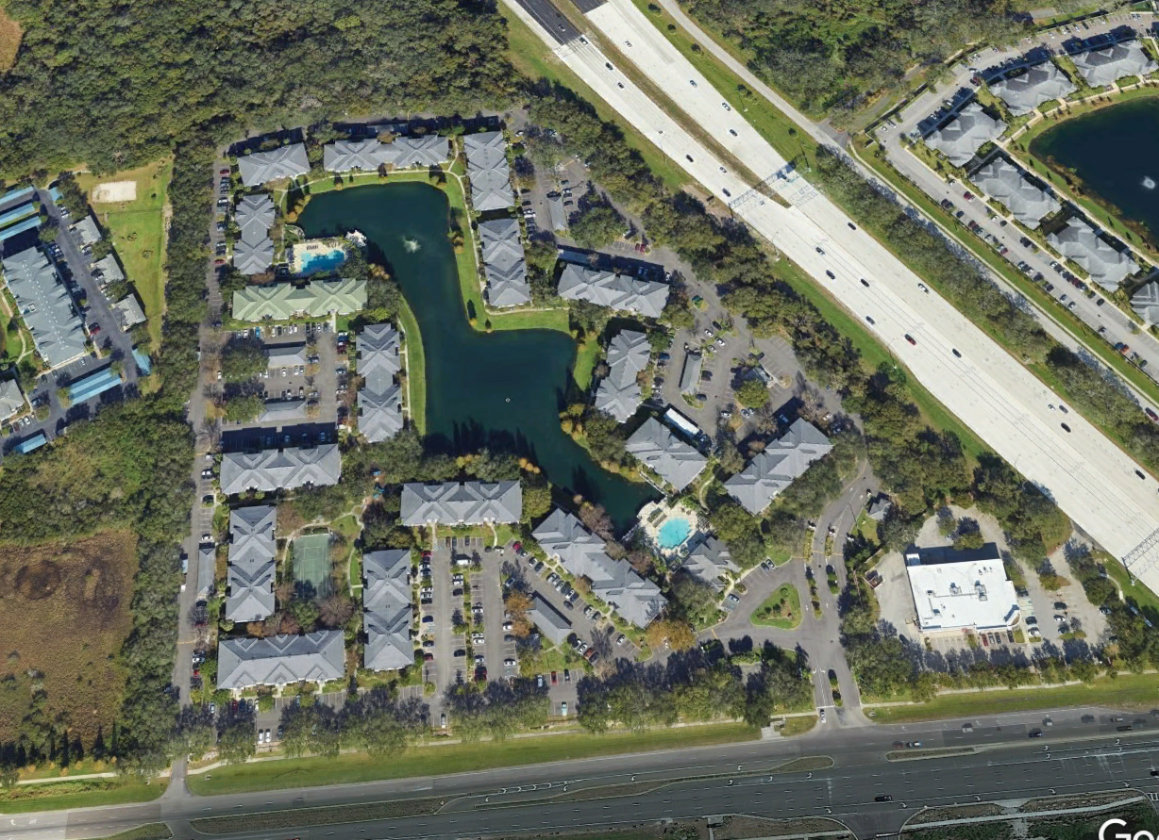
SUBURBAN APARTMENTS
The most least sustainable and walkable type.

Slide 15
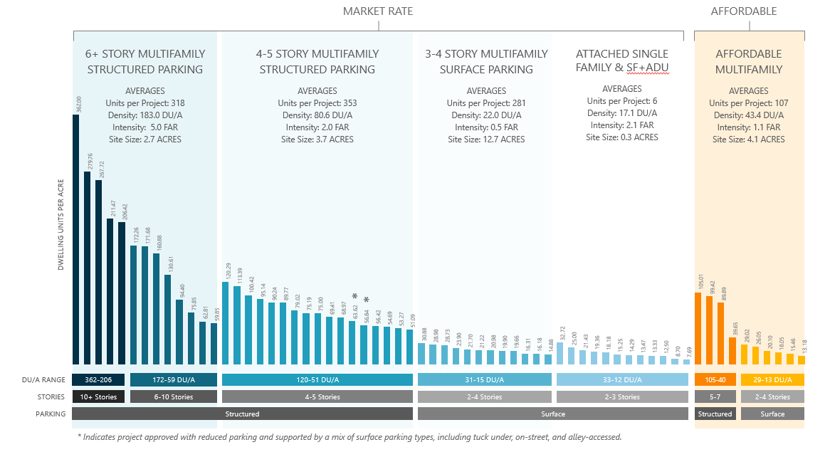
SUBURBAN APARTMENTS
Standard suburban apartments.
Limited transit-supportiveness not often designed in walkable configurations.
Projects average 22 DU/A due to space needs for surface parking and drainage.
Mega-block (+10 acre) layout.
Parking in 1-2 bay configurations across site.
Typically single use and suburban form.
Limited potential to support walkable urbanism. Typically, little head room to create attractive bonuses provisions and limited potential for parking reduction given conventional scale and form or projects.
Avg Units per Project: 281
Avg Density: 22.0 DU/A
Density Range: 15-31
Avg Intensity: 0.5 FAR
Avg Site Size: 12.7 ACRES

Slide 16
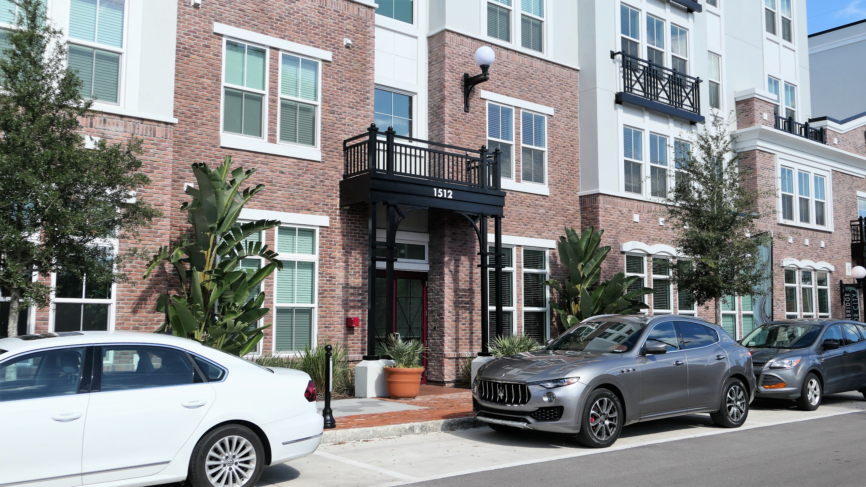
TEXAS DONUTS
The building blocks of walkable urban places.

Slide 17
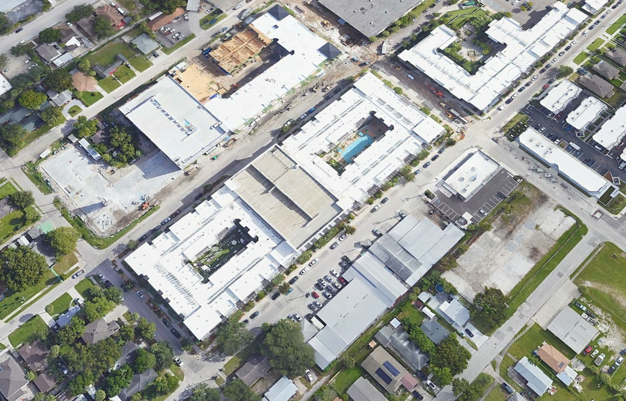
TEXAS DONUTS
Transit-supportive densities and walkable forms.
“Texas Donut” type with stick-built units wrapping a midblock parking structure OR above a single story concrete podium.
Parking mostly screened from public view.
Potential for active frontage on all sides—storefronts and walk out ground level units.
Vaulted stormwater under parking and courtyards.
Most codes with “head room” to allow for attractive bonus provisions. Coding should focus on ground floor frontage (active uses, clear ceiling heights, street entries, and transparency), parking access and screening, and transition to lower scale neighbors.
Avg Units per Project: 353
Avg Density: 80.6 DU/A
Density Range: 51-120 DU/A
Avg Intensity: 2.0 FAR
Avg Site Size: 3.7 ACRES

Slide 18
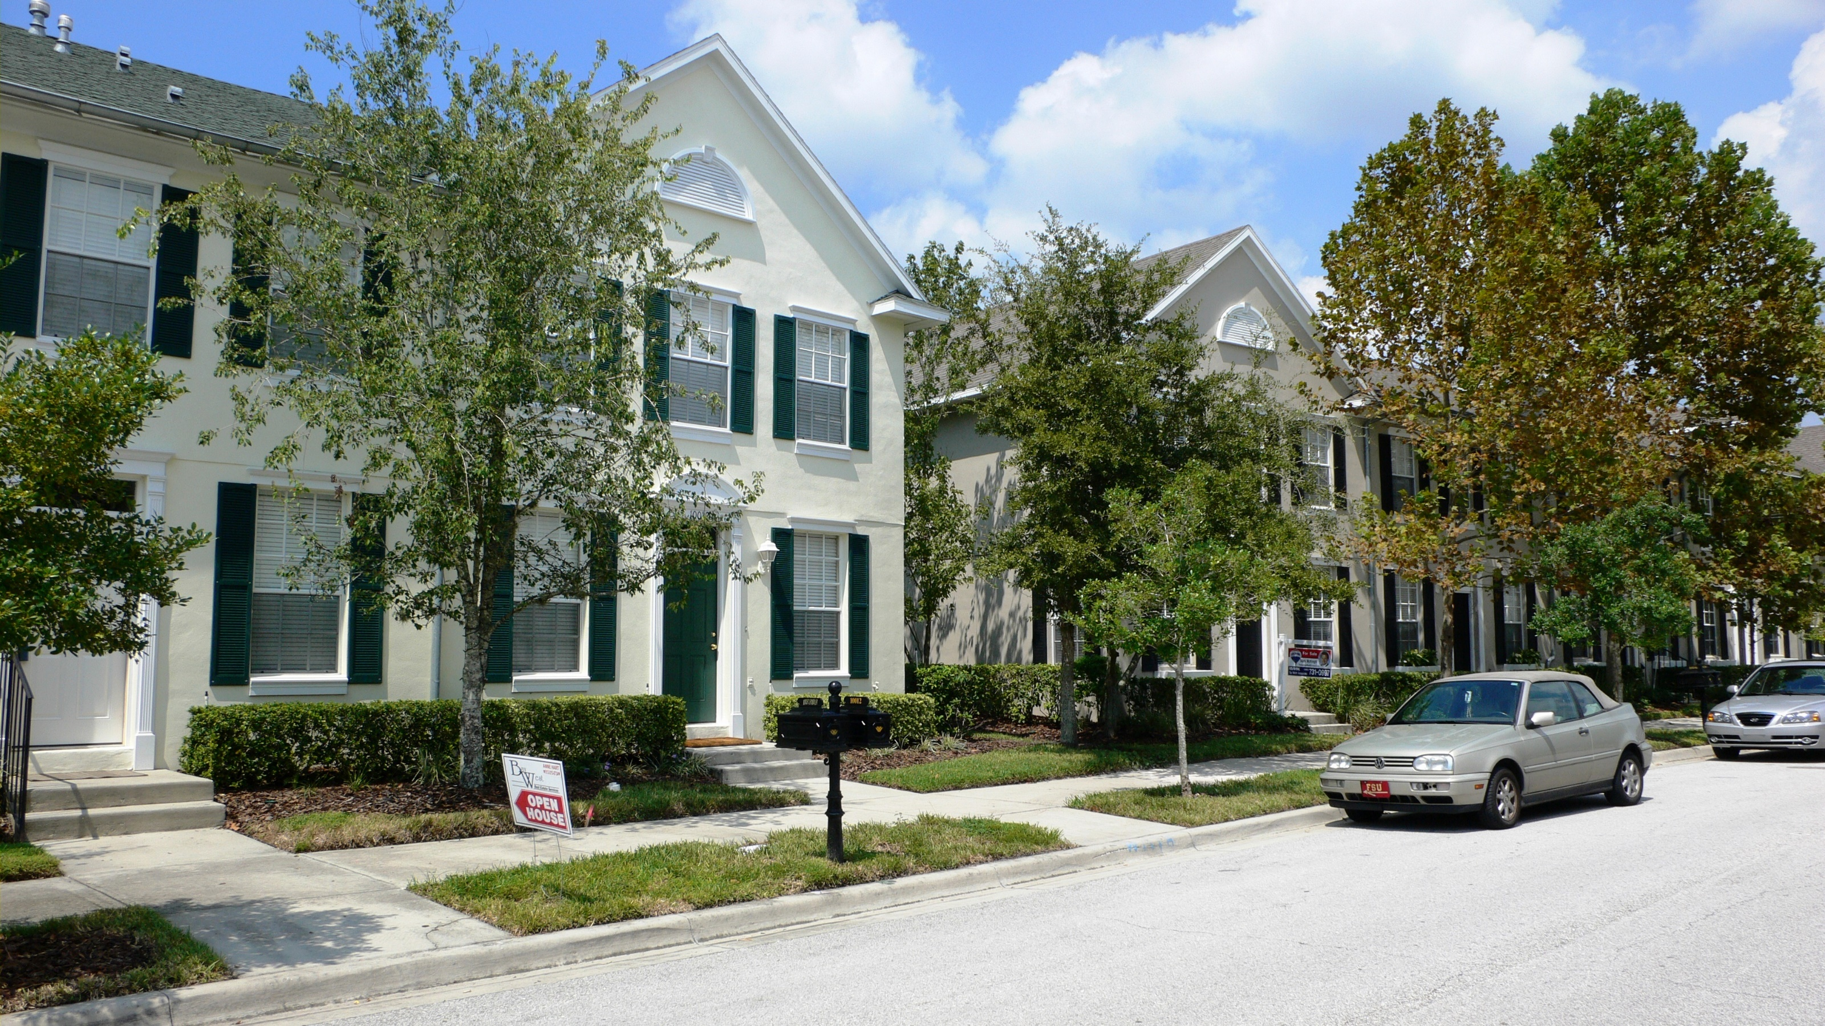
MISSING MIDDLE TYPES
The swiss army knives of urbanism.

Slide 19
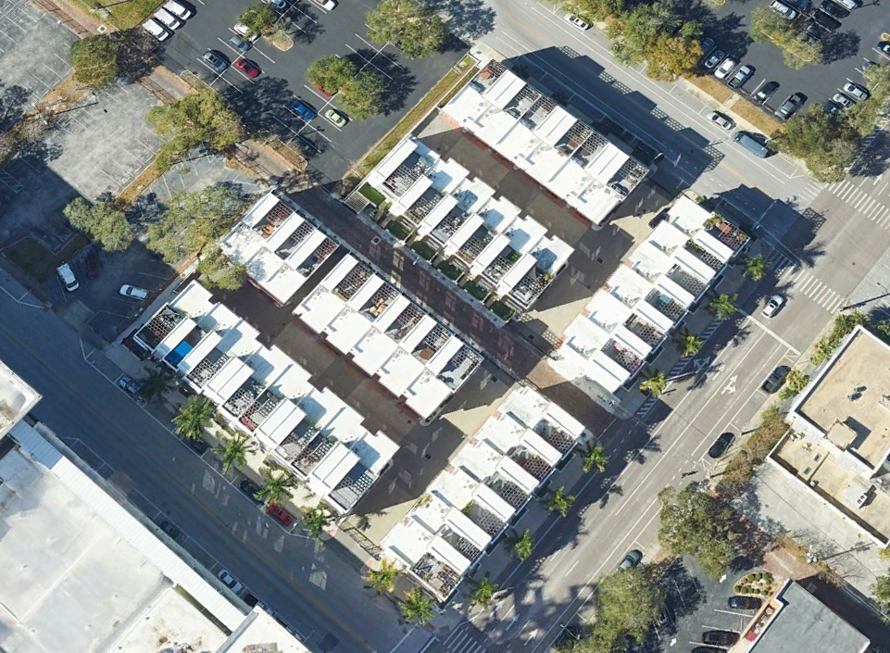
MISSING MIDDLE TYPES
Ideal types for urban infill, transit-oriented, and downtown adjacent locations.
Walkable forms at high range in densities and site sizes.
Strong potential as transitional uses between centers/corridors and adjacent neighborhoods.
High flexibility in configurations to address site constraints.
Most codes with “head room” to allow for attractive bonus provisions. Coding should focus on orientation, frontage conditions, and parking location and access.
Avg Units per Project: 6
Avg Density: 17.1 DU/A
Density Range: 8-33 DU/A
Avg Intensity: 2.1 FAR
Avg Site Size: 0.3 ACRES

Slide 20
TYPOLOGY GAP
Densities range from 22-80 DU/A with gap from 30 to 50.
The gap is both practical and financial—a function of site area required for parking and the cost of structured spaces.
OUTLIERS
Two surface-parked projects broke the pattern. Projects rec’d substantial parking reductions and used a mix of tuck, on-street spaces, and alley accessed spaces.
MARKET RATE
4-5 STORY MULTIFAMILY
STRUCTURED PARKING
Avg Units per Project: 353
Avg Density: 80.6 DU/A
Density Range: 51-120 DU/A
Avg Intensity: 2.0 FAR
Avg Site Size: 3.7 ACRES
2-4 STORY MULTIFAMILY
SURFACE PARKING
Avg Units per Project: 281
Avg Density: 22.0 DU/A
Density Range: 15-31
Avg Intensity: 0.5 FAR
Avg Site Size: 12.7 ACRES
0UTLIERS
*
*
THE GAP
DU/A RANGE
31-15 DU/A
2-4 Stories

Slide 21
KEY TAKE AWAYS

Slide 22
KEY TAKE AWAYS
Account for types when planning and coding.
Calibrate codes to address financial, typological, and physical realities.
Use Test Fits & Feasibility Studies to inform coding.
Avoid the “Gap” between 30 and 50 DU/A. Density increases in steps, not along a line or curve.
To maximize efficiency, fiscal benefits, and sustainability, advocate for higher densities and parking reductions.

Slide 23
KEY TAKE AWAYS
Density’s only one piece of the puzzle.
Form impacts perception more than density.
Both 50 and 100 DU/A can be delivered in the same form. From the public’s perspective, these can look and feel exactly the same.
Projects with 20 and 100 DU/A can comfortably coexist with good form-based coding and thoughtful design.
Use form-based standards to address frontage condition, scale transitions, and parking configuration.
Make the outcome you desire the easiest outcome to deliver.

Slide 24
THANK YOU!
Stefanie McQueen, AICP
stefanie.mcqueen@hdrinc.com
Steve Schukraft, AICP
steve.schukraft@hdrinc.com

Slide 25
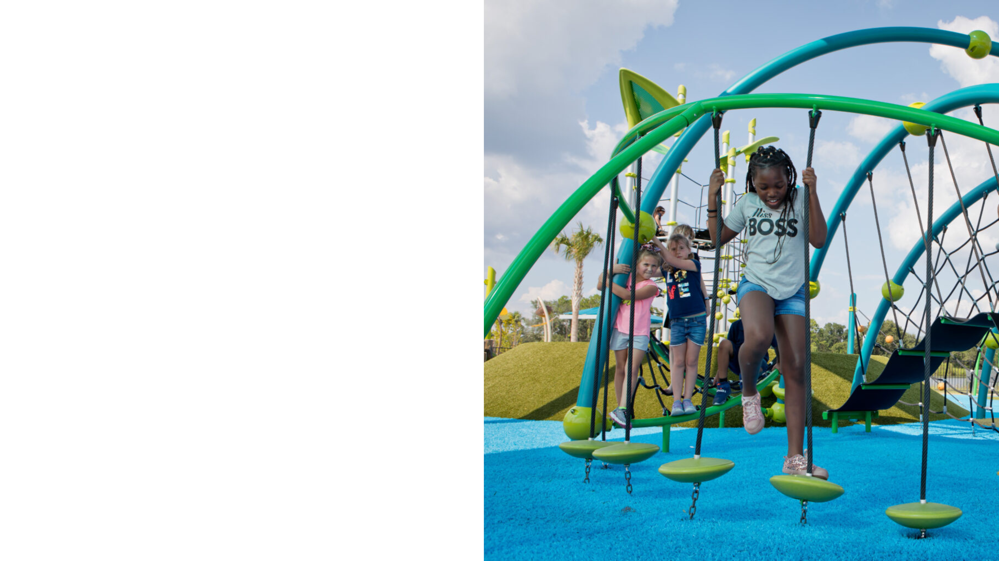


Centers & Connections: Incentivizing Infill and Diverse Housing in Unincorporated Hillsborough County
Katrina Corcoran, AICP
2024 Florida Association of Counties Conference
June 26, 2024
PlanHillsborough.org/hclanduse

Slide 26



Addressing Future Growth
By 2045, unincorporated Hillsborough County will see…
350,000
MORE PEOPLE
107,000
MORE JOBS
& Increasing demand for…
TRANSPORTATION
COUNTY SERVICES
SCHOOLS
RECREATION
Notes:
By 2045, Unincorporated Hillsborough County will see 350,000 more people and 107,000 more jobs. We’ll also have an increasing demand for transportation, public county services, schools, and recreation.
That’s what this update is all about. We’re trying to identify how we should grow and where we should grow.

Slide 27

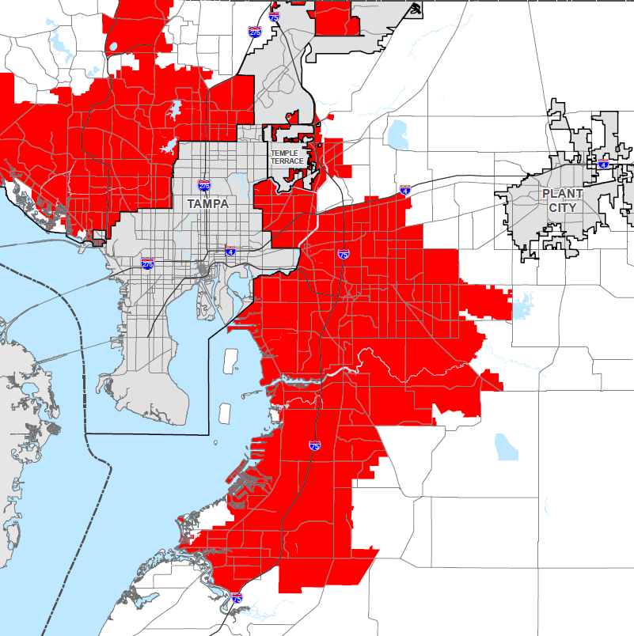
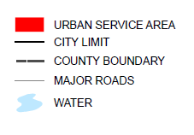
Urban Service Area
Part of the adopted Future Land Use Element’s Growth Management Strategy
Pinpoints where current growth is focused
Identifies urban/suburban development and rural areas
Helps to create compatible development patterns that efficiently utilize land and county services
20%
Land that is vacant, developable or redevelopable within the Urban Service Area
Source: Planning Commission, Jan. 2023
*Note: 2,110 acres annexed by Plant City since 2015
Notes:
The Urban Service Area is a part of the Future Land Use section and pinpoints where current growth is focused. Here on the screen, you can see the RED area is the Urban service area, and the square is Hillsborough County.
One thing that is unique about Hillsborough County is that we have choices on where we want to live – in an urban area, in the suburbs, or in a more rural area. The Urban Service Area is what identifies urban, suburban, and rural areas throughout the county allowing us to have these choices. But as we continue to grow, we know that we are running out of land that is vacant, developable, or redevelopable within the Urban Service Area.

Slide 28


Land for Future Development and Redevelopment
49,908 TOTAL ACRES
32,661 (65%)
Total Acres In the Urban Service Area
Developable and redevelopable land within Plant City, Tampa, Temple Terrace, and the Urban Service Area
17,247 (35%)
Total Acres In Plant City, Tampa, and Temple Terrace
Source: Planning Commission, October 2023
*Note: Plant City has annexed 2,110 acres since 2015
Notes:
There are 49.908 total Developable and redevelopable acres within Plant City, Tampa, Temple Terrace and in the urban service area. Of that acreage, 65% is in the urban service area. While 35% is in the combined municipal areas.

Slide 29
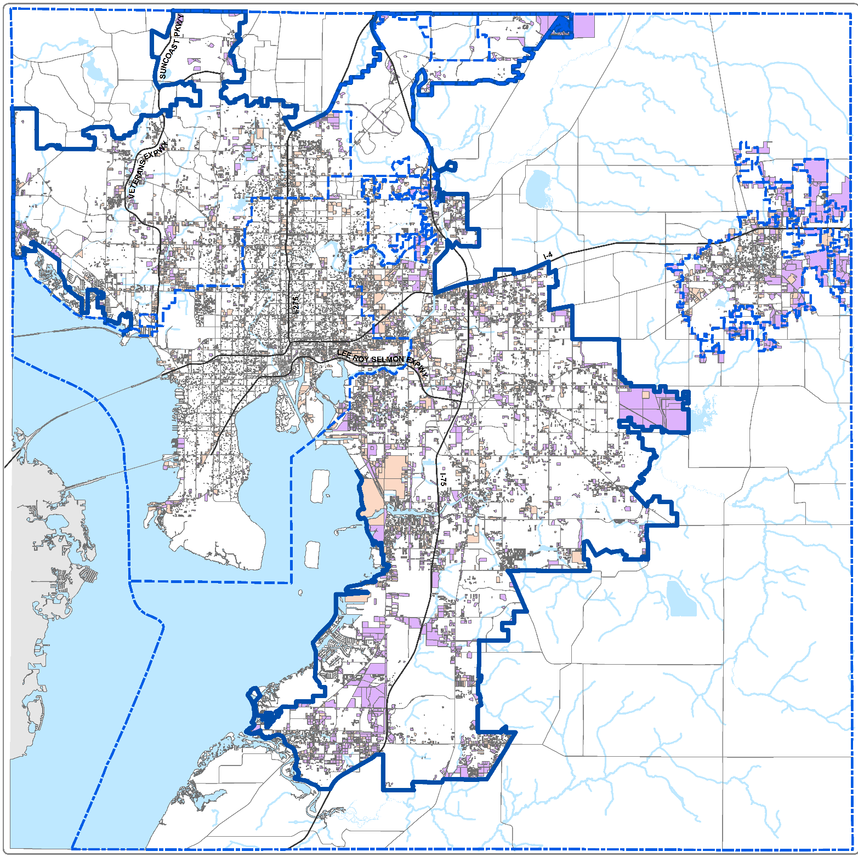
DEVELOPABLE
REDEVELOPABLE
*excludes wetlands
Notes:
On this map you can see the developable acreage in purple and the redevelopable acreage in orange. The developable acreage and the redevelopable acreage excludes our wetlands and other conservation areas. And you can see that most of this land is very small in size. There are very few large lot sizes left.

Slide 30
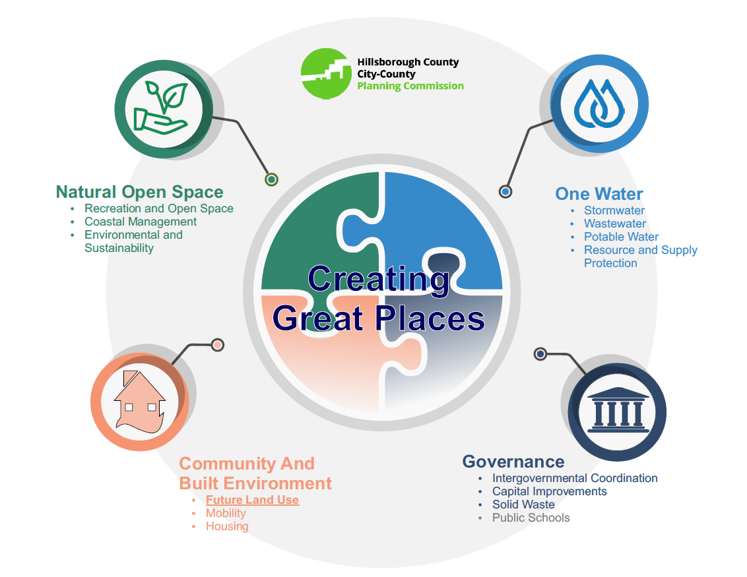
The Comprehensive Plan can…
Envision Future Growth
Provide Consistency
Prioritize Funding
Protect Resources
Legally required
Typically updated every 7-10 years
Notes:
A little bit about our Comprehensive Plan - Essentially, it’s a legally required document that envisions future growth, provides consistency, prioritizes funding, and protects resources and it’s updated every 7-10 years.

Slide 31
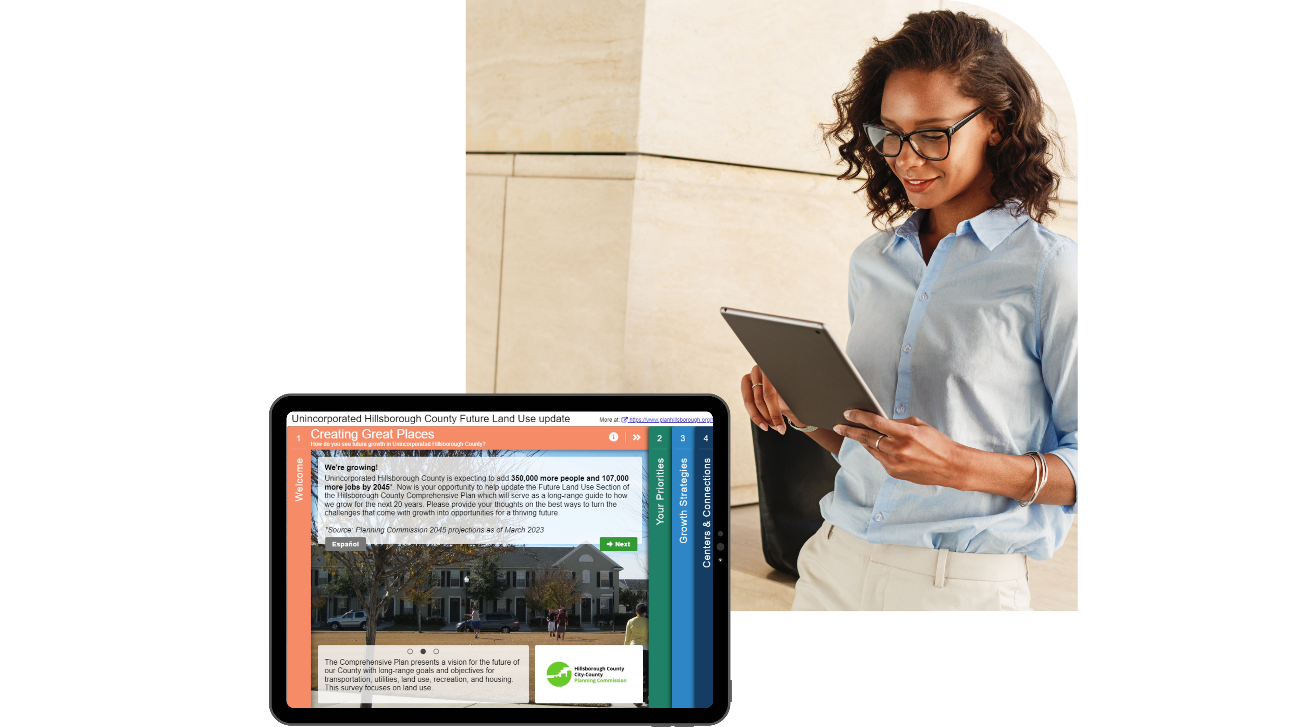
Public Outreach
MetroQuest survey with 1,800+ participants
32,000+ data points collected
1,600+ comments submitted overall
5,600+ mapping data points
Multiple outreach meetings
May 16 (in-person in Brandon)
May 23 (virtual, recorded)
May 24 and June 28 (in-person in Palm River)
July 26 (in-person, Bay Area Apartment Association)
Nov. 2 (in-person in Gibsonton)
Nov. 6 (virtual, recorded)

Slide 32
Survey Results: Inward Growth
Question: How important is each strategy when considering inward growth (within the Urban Service Area boundary)?
Most Important: Efficiency of Existing Infrastructure
Relative to the other options, maximizing existing infrastructure was the most important strategy when focusing on inward growth
Least Important: Variety of Housing Types
Variety of housing types was ranked as the least important of the four options
Notes:
When looking at the growth inward, within the Urban Service Area, participants felt that maximizing existing infrastructure was the most important strategy while Variety of housing types was ranked as the least important.
However, even 25% of participants thought a variety of housing types was most important, so we know we still need to prioritize this.

Slide 33

Survey Results: Inward Growth
Question: How important is each strategy when considering inward growth (within the Urban Service Area boundary)?
1 = not effective or important, 5 = extremely effective or important
Efficiency of existing infrastructure
An average of 4.36 out of 5
52% of respondents ranked it 5
Safe walking and biking
An average of 4.23 out of 5
49% of respondents ranked it 5
Close to daily needs
An average of 4.02 out of 5
38% of respondents ranked it 5
Variety of housing types
An average of 3.36 out of 5
25% of respondents ranked it 5
Notes:
In addition to maximizing existing infrastructure, participants also wanted to see safe walking and biking and being close to daily needs.

Slide 34
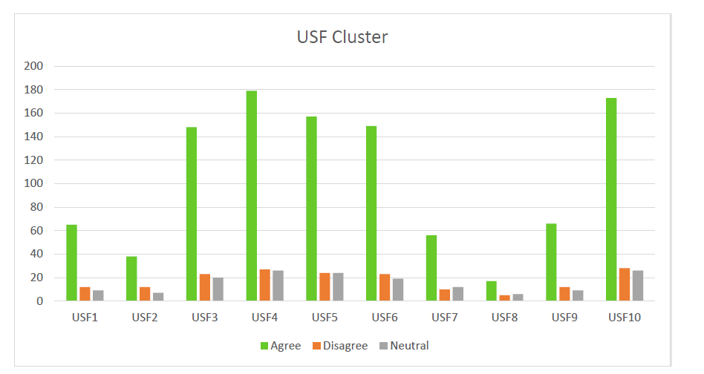
Survey Results: Mapping
Notes:
Positive mapping example
Support for redevelopment and infill
Area is suitable for increased density and mixed-use
Area needs more infrastructure improvements
Comments on the area’s potential due to USF and the hospitals
Desire for improved transit and housing options, including affordable housing
Noted that traffic is bad in the area and concerns for increasing it
Desire for bike/walk improvements and trails in the area

Slide 35
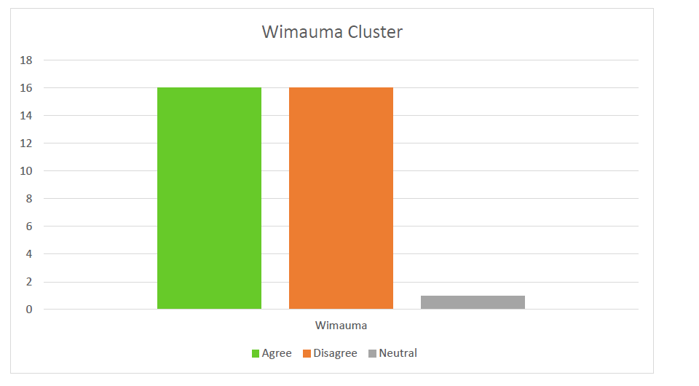
Survey Results: Mapping
Full survey results & tech memo available at: PlanHillsborough.org/hclanduse
Notes:
Mixed to negative mapping example
Desire for more commercial uses and shopping options
Desire for keeping some areas rural
Concern for protected species in the area
Concerns over overdevelopment, traffic congestion, and insufficient infrastructure
Concerns over gentrification and pushing out existing residents

Slide 36
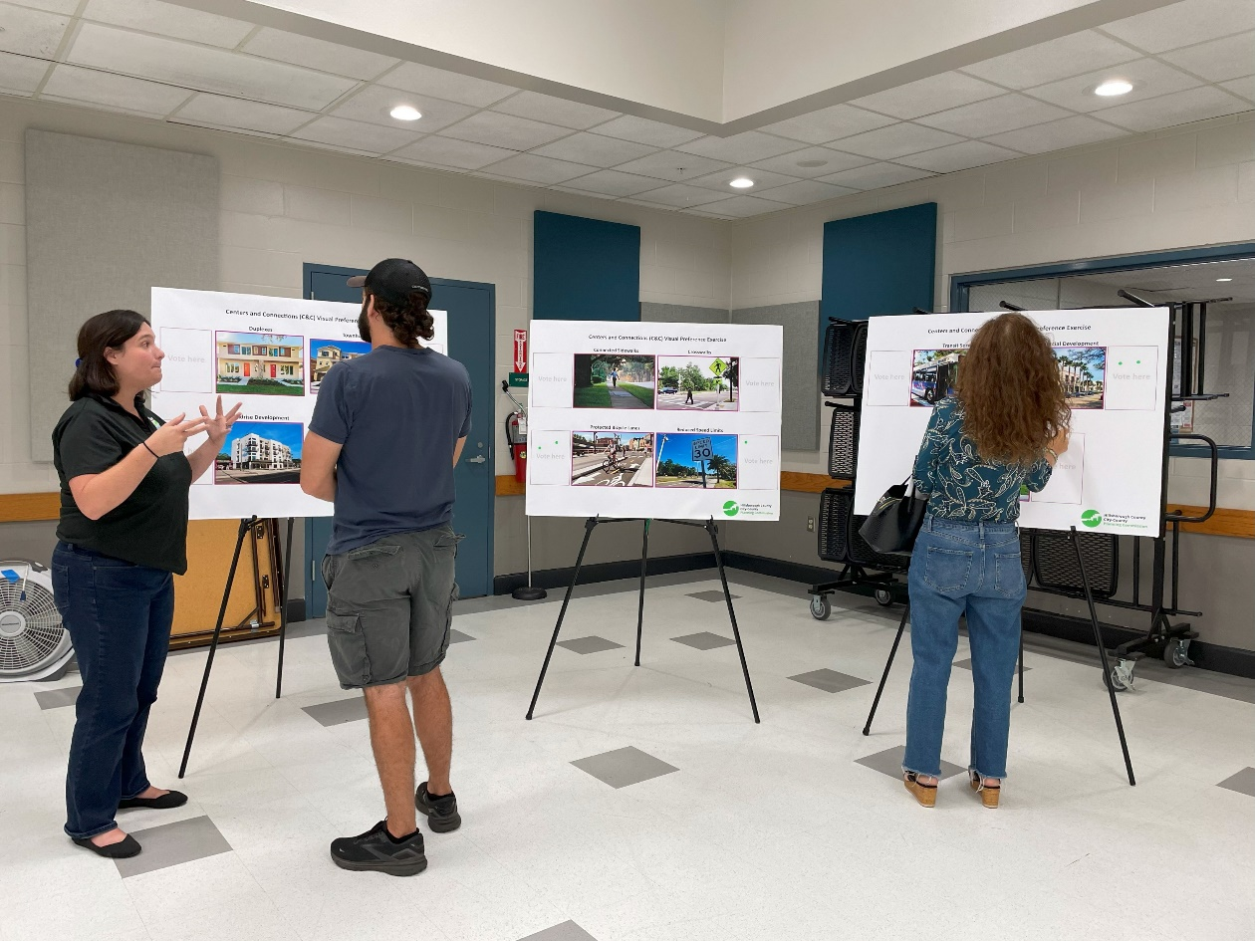
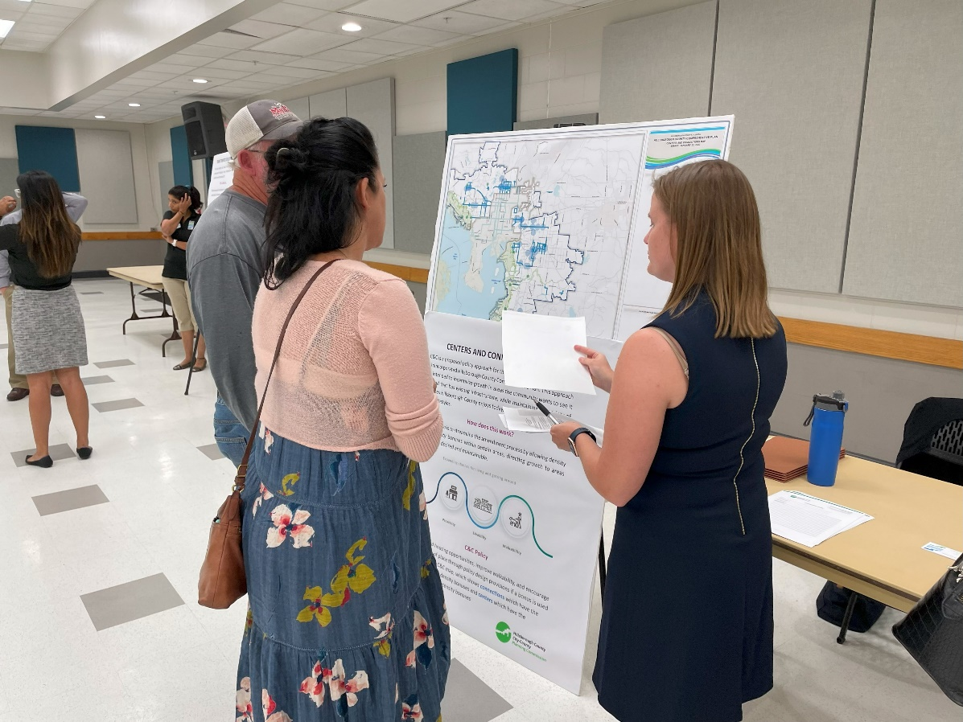
In-Person & Virtual Meetings
Visual Preference Exercise
High support for:
Public greenspace
Connected sidewalks
Medium support for:
Duplexes
Mixed-use development
Reduced speed limits
Lower support for:
Transit
Townhomes
Mid-rise development

Slide 37








EMPHASIS ON
SAFETY
What We Heard
o
o
o
o
Driving
Walking
Cycling
Student transportation to school
Preserve Natural/Environmental Spaces
Traffic/Mobility/Accessibility problems, especially during peak hours
Consider current neighborhood character and strategic density increases
Limited access to emergency services and mobility choices
Need more affordable housing and a variety of housing types
Schools chronically overcrowded
Residential should be closer to daily needs
Notes:
Throughout our public meetings and project advisory team meetings, we heard very similar priorities. We were able to take a deeper dive into some of these details. Some common themes included preserving natural spaces, managing traffic and accessibility, maintaining current neighborhood character, and increasing the amount of affordable housing.
Participants also had a significant emphasis on safety – from people driving, to walking, biking, and getting to jobs, schools, and overall daily needs.

Slide 38
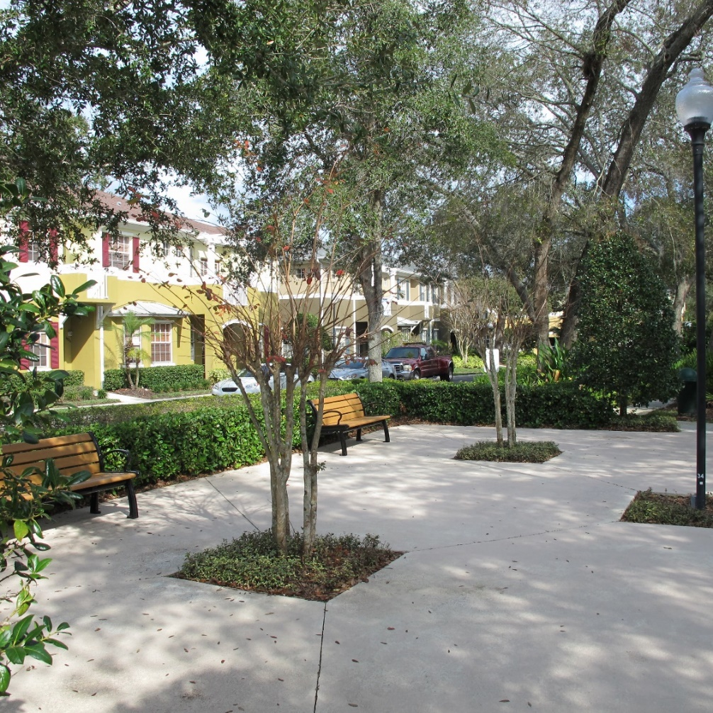
Centers and Connections
How will this work?
Part of the Future Land Use Section update
Encourage growth in areas where communities desire it by allowing density and intensity bonuses in specific centers and corridors, in line with adopted Community Plans within the Urban Service Area (USA)
Expand housing opportunities, improve walkability, and encourage a sense of place
Notes:
Hillsborough County is experiencing and will have continue to have high population growth, along with the number of issues that brings (for example, increased traffic or lack of diverse or affordable housing). This policy approach will help direct growth to specific centers and corridors via bonuses, in line with adopted Community Plans within the Urban Service Area. Density is the number of units developed on a piece of land. Residential density is measured by dwelling units per acre (du/ac). Any increase in density via a proposed bonus would be an increment over the existing density, to remain appropriate for the context and character of existing areas. Intensity measures development building size with Floor Area Ratio (FAR). FAR is measured by total square footage of a building on a site by the amount of site square footage. A FAR bonus could encourage mixed use, service, and jobs near residential development. Overall, the goal of this approach is to expand housing opportunities, improve walkability, and encourage a sense of place. These areas are also in line with existing transit routes and may continue to have transit in the future.

Slide 39
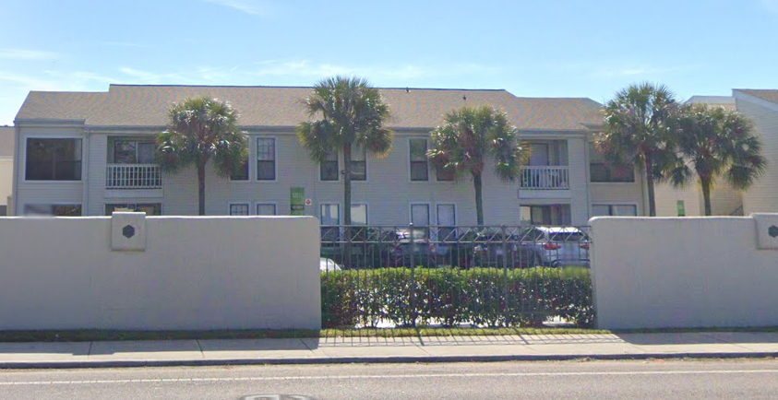
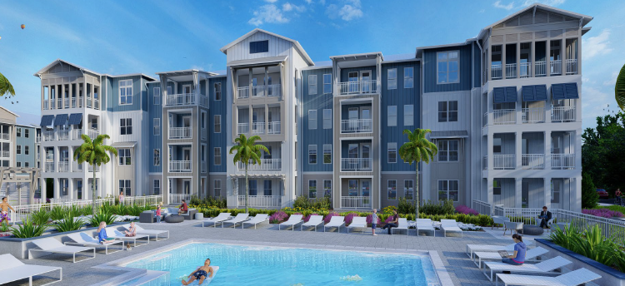
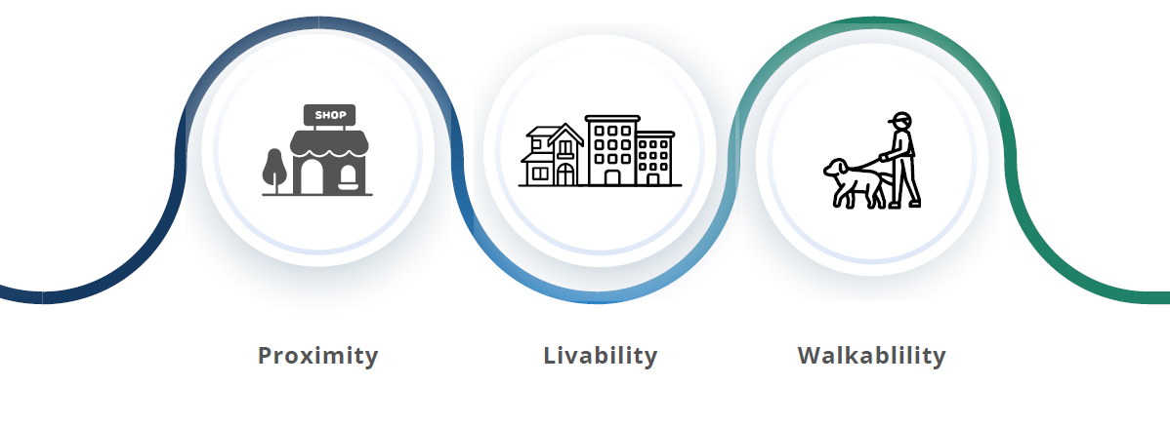
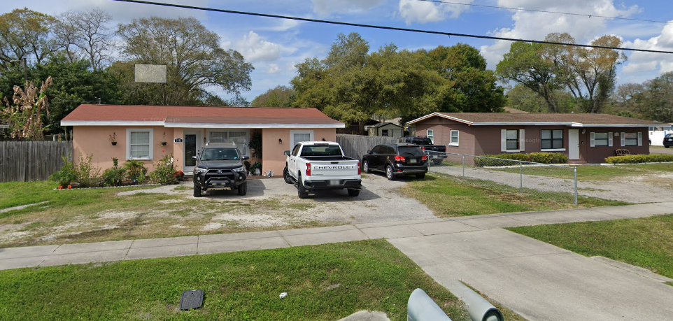
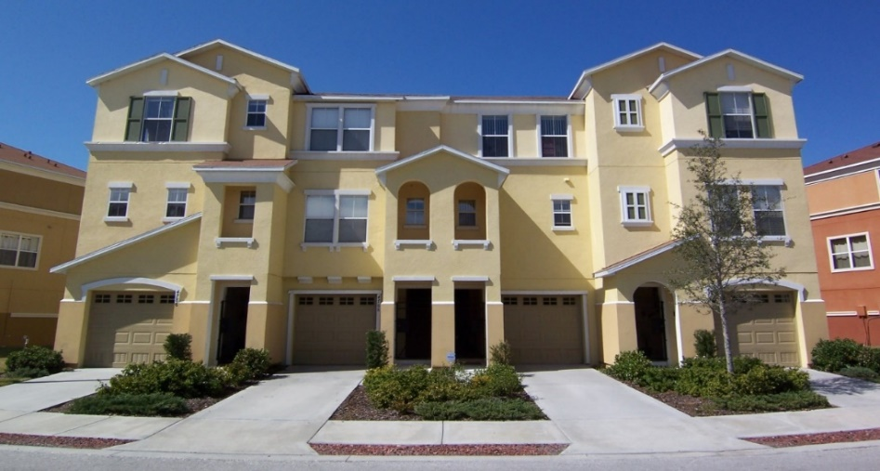
Centers and Connections
BEFORE…
AFTER…
USF AREA
Expanding choices for living and getting around
Residential with 20 units per acre
Residential with 35 units per acre
Focuses on centers and corridors that are coordinated with Community Plans and major intersections
Expands housing opportunities and choices
Encourages more pedestrian friendly development
Allows for a bonus in density or intensity to the next land use category
PALM RIVER
Residential with 9 units per acre
Residential with 15 units per acre
Notes:
Centers & Connections is a policy approach within the Future Land Use Section, specifically to implement proposed FLU Goal 2. The intent to is to streamline the Comprehensive Plan amendment process by allowing density and intensity bonuses within certain areas of Unincorporated Hillsborough County, essentially directing growth to areas where it is desired and maintainable. Those bonuses would be tied to specific design provisions and required improvements as a part of development, meaning there would be public benefits if someone were to choose to use it. This approach would be incentive-based, meaning that it would be an option for property owners but not a requirement. Overall, this approach is intended to incentivize growth in areas the community wants to see it and that has existing infrastructure, while maintaining the variety of choices Hillsborough County enjoys today, such as urban, suburban, and rural lifestyles.

Slide 40

Map Methodology
CONNECTIONS
CENTERS
On roads that have either:
An adopted roadway context designation that supports more walkability
Future Land Use categories that already support the potential for higher density
Corridors in the CHHA are excluded
Potential for density bonuses along these corridors
Include major intersections and areas identified in Community Plans for redevelopment or walkability
Potential for intensity and density bonuses within centers
Notes:
In order to direct growth, staff have developed a map showing these Centers & Connections. This slide gives more background information on how these were selected and what they have the potential for.

Slide 41

Map Updates
Concept Support
Significant support for the concept in the northern portion of the County within the USA, especially the USF Area & East Lake Orient Park
Map Revisions
Less support and mixed-reactions for portions of Brandon
Addressed concerns about centers and corridors in South County, especially Sun City Center
Simplified applicable areas
Staff reviewed and considered revisions as needed
Staff also considered comments for policy impacts
Notes:
The MetroQuest survey allowed the public to put a thumbs up, thumbs down, and neutral icon on the proposed centers and connections. After analyzing those and comments received in the mapping portion of the survey, staff noted significant support for the concept in the northern portion of the County within the Urban Service area, especially in places like the University Area and East Lake-Orient Park. The updated version of the proposed map incorporates edits such as a closer look at the Brandon area (which received mixed reactions) and concerns about centers and connections identified in South County. Staff simplified the applicable areas of this concept.

Slide 42
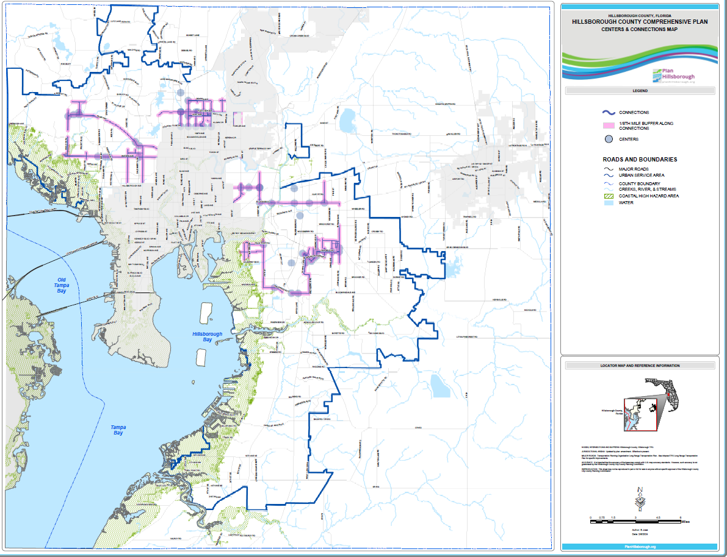

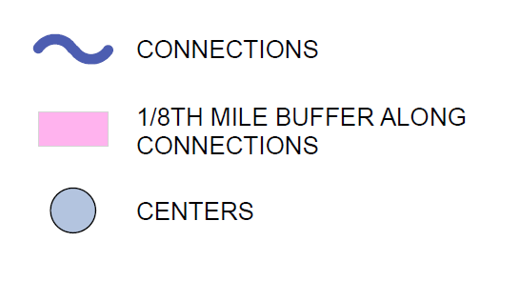
Centers & Connections Map

Slide 43
Policy Language
(1) Defining the Centers & Connections (C&C) concept
How they should be reviewed during FLU map amendments and rezoning applications
(2) Policy language for all C&Cs regardless of bonus usage
Diverse housing types, mixed-use development, multimodal investments
(3) Density & intensity bonus table & locations
Planned development rezoning application is required
Connection to Transit-Oriented Development (TOD) and Transfer of Development Rights (TDRs), and affordable housing
Modest, compatible increases in density
(4) Design criteria
Building design and orientation
Access management
Sidewalks
Landscaping
Green & open space

Slide 44
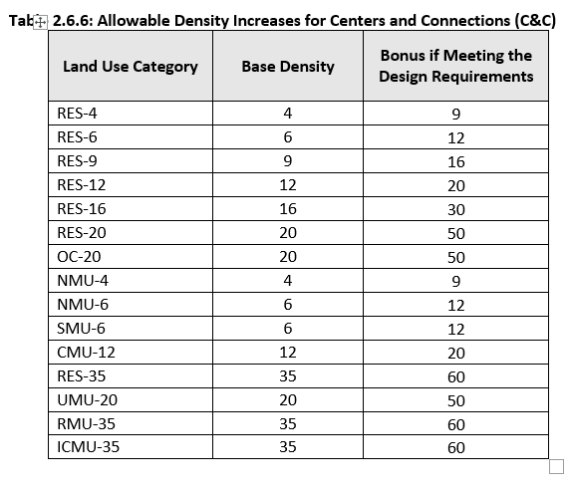
Policy Language
Density & intensity bonus table

Slide 45


Next Steps
March 2024
June 2024
August 2024
January 2024
2024
Planning Commission Recommendation
Found consistent
Hillsborough County BOCC
Transmittal Hearing
Transmitted to the state
Hillsborough County BOCC
Adoption Hearing
Continued to August Hearing
Hillsborough County BOCC
Adoption Hearing
Upcoming

Slide 46
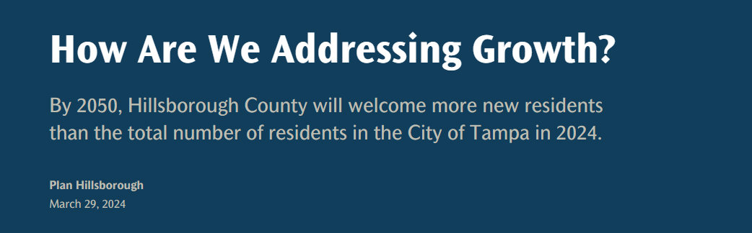
Growth Management Strategies
Interactive GIS Story Map
To meet the demands of new residents, growth management techniques are crucial to ensuring necessary services are available
Plan Hillsborough is addressing the challenges that accompany such growth by looking at different proactive strategies
Link to the webpage
C&C listed as an example of Redevelopment Opportunities
Once adopted, see how the bonus is utilized (and adjust as needed)

Slide 47

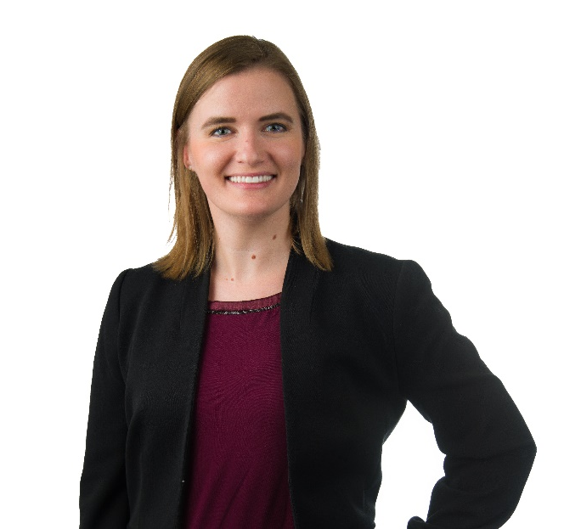
Thank you!
Katrina Corcoran, AICP
Principal Planner
Hillsborough County City-County Planning Commission
I look forward to your questions during Q&A!

Slide 48




Integrating Mobility Focused Land Use, Zoning Reform and Housing in Tampa Bay
Florida Association of Counties Annual Conference
June 26, 2024

Slide 49
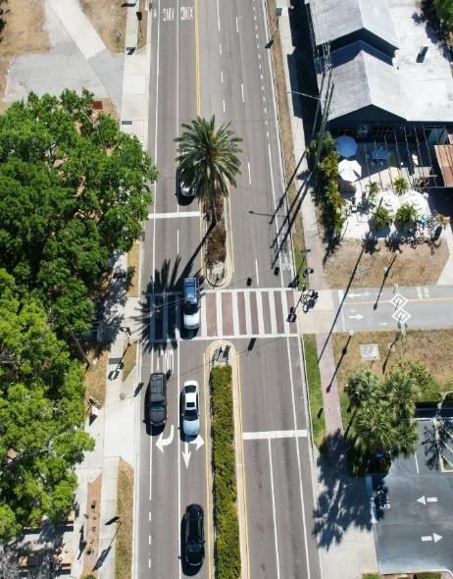


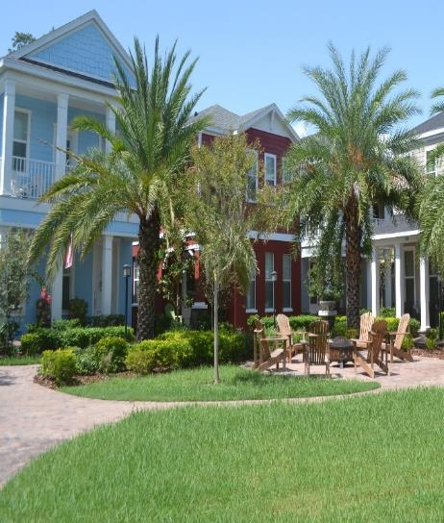
ABOUT US
PINELLAS PLANNING COUNCIL
Maintain the Countywide Plan which governs densities, intensities, and uses across Pinellas County
METROPOLITAN PLANNING ORGANIZATION
Develop transportation plans, programs, and priorities for State and Federal funding
“INTEGRATING LAND USE AND TRANSPORTATION”

Slide 50
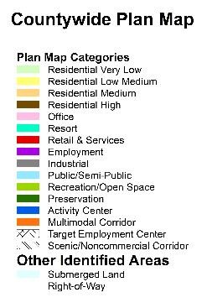
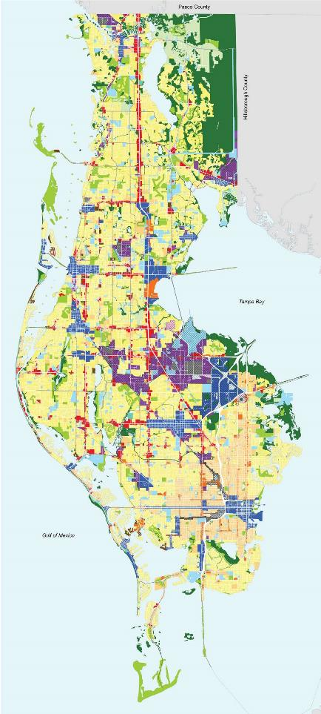
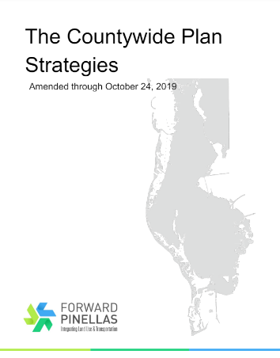
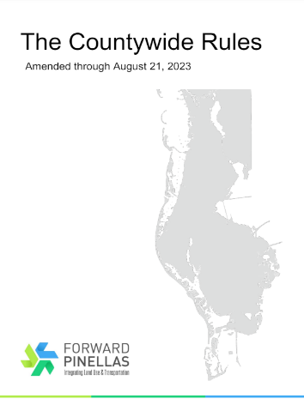
The Countywide Plan
Coordinates land use among the 25 local governments in Pinellas County – densities, intensities, and uses
Guides land use with transportation priorities and other countywide considerations
Updated to respond to meet local needs – bonus provisions
Knowledge Exchange Series / Pilot Program Grants / Information Clearinghouse

Slide 51
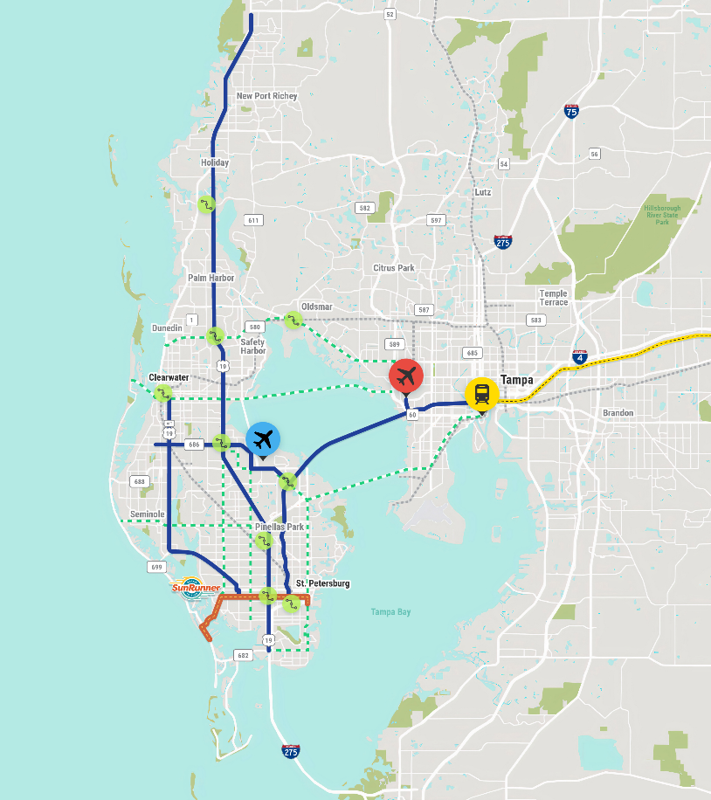
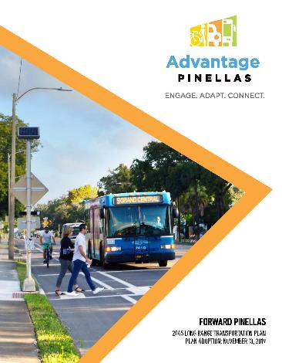
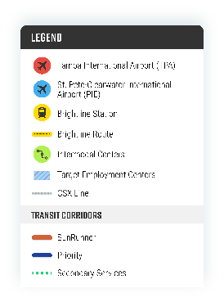
Long Range Transportation Plan
Advantage Pinellas - 2045 Long Range Transportation Plan (LRTP) for Pinellas County
Strategic plan to improve mobility and economic opportunity countywide
Defines major transportation needs and enables our communities to receive critical future funding
Ties together land use, transportation & housing
If a transportation project is not included in the plan, it cannot be eligible for state or federal funding and may not be built.
Notes:
The LRTP is the main transportation policy document
LRTP identifies all of the transportation needs for the next 20 years that align with the desired future land use context for the community, and then identifies the funding to get them done
The LRTP is updated every 5 years to account for changing demographic and economic conditions

Slide 52
Pinellas County Development (1950-2024)

Slide 53
Pinellas County Development (1950-2024)

Slide 54
Pinellas County Development (1950-2024)

Slide 55
Pinellas County Development (1950-2024)

Slide 56
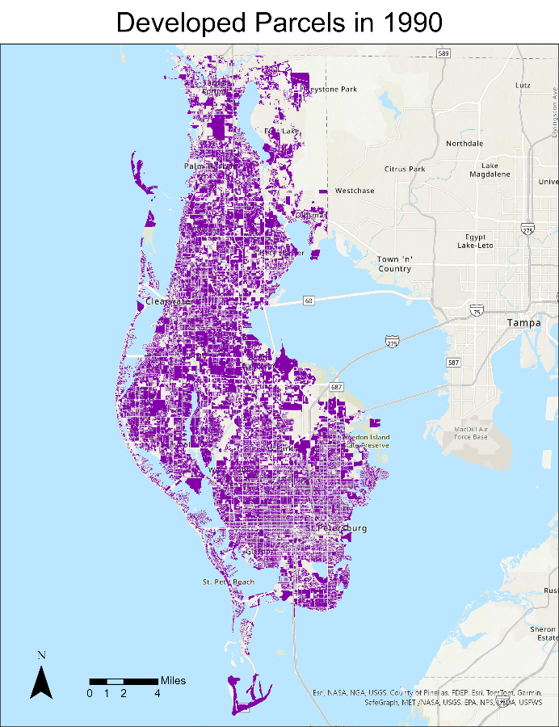
Pinellas County Development (1950-2024)

Slide 57
Pinellas County Development (1950-2024)

Slide 58
Pinellas County Development (1950-2024)

Slide 59
Pinellas County Development (1950-2024)

Slide 60
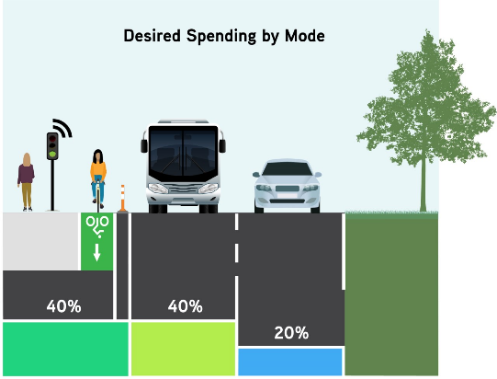
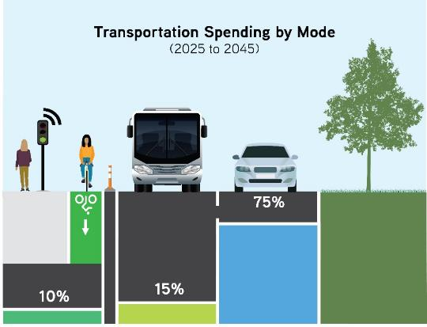
Pinellas County Facts and Figures
Most densely populated county and second smallest county by land area in Florida
Redevelopment context
Peninsula on a peninsula
13 of 25 local governments are located on shoreline
25
15M
120K
980K
80K
Local Governments
Annual Visitors
New Residents
New
Jobs
Residents
Over the next 25 years
Notes:
3,400 people per square mile (most dense)
280 square miles (2nd smallest land area)
Very little vacant land left
25 local governments of varying sizes and community character
Projecting another 120,000 residents and 80,000 jobs over the next 25 years

Slide 61
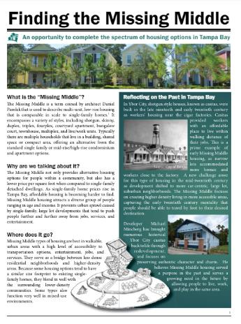
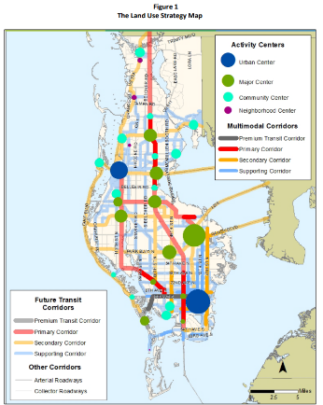
The Redevelopment Opportunity
“Finding the Missing Middle” Housing Study (2017)
Countywide Plan amendments (2019) increased growth opportunities within the “centers and corridors” framework
Strategy supports 30 transit-oriented centers linked by various corridors in the appropriate locations
Integrates land use and transportation decision-making and preserves neighborhood and community character

Slide 62
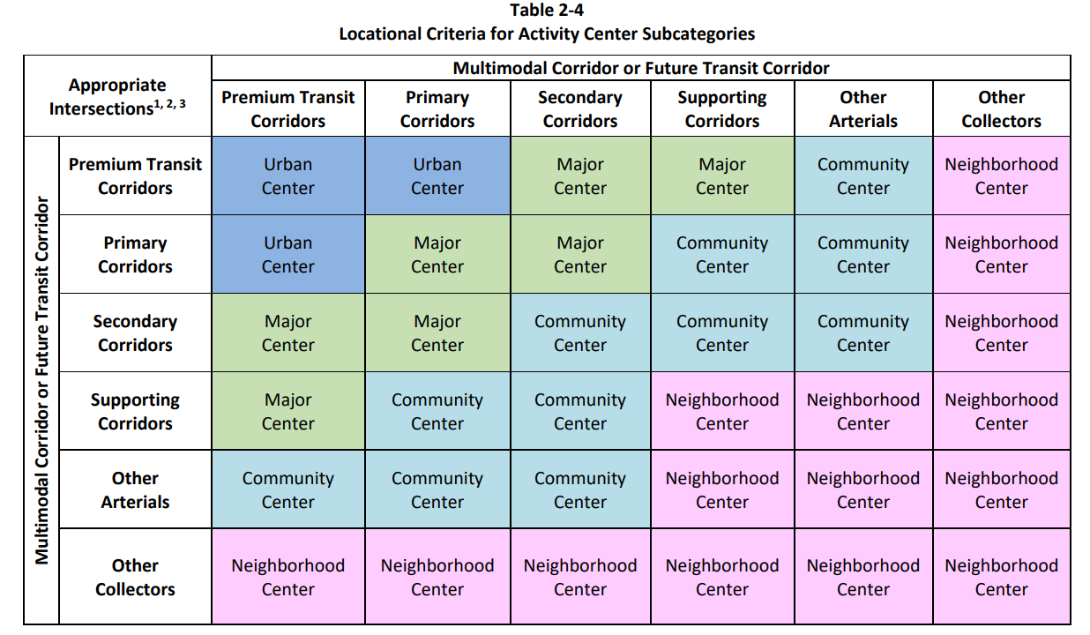
Activity Center Locational Criteria

Slide 63

Activity Center Maximum Standards

Slide 64

Multimodal Corridor Maximum Standards

Slide 65

Pinellas County Migration
Forward Pinellas + Pinellas County Economic Development
Pinellas County attracted, on average, 21 net new residents per day between 2017 and 2021
Residents leaving Pinellas County are largely moving to Pasco County and Polk County
Workers earning lower wages cannot afford housing in Pinellas County
Notes:
We frequently partner with Pinellas County Economic Development to try and solve our most pressing challenges
Housing is one of those challenges and this slide summarizes the migration statistics for Pinellas County
21 net new residents per day between 2017 and 2021
During this time period, most residents moved to Pasco or Polk County

Slide 66
Pinellas County Housing Demand
To accommodate projected household growth and changing demographic trends, an additional 3,345 new housing units need to be constructed annually between 2022 and 2035
Between 2013 and 2022, an average of 2,530 units were permitted per year in Pinellas County
New home types should be varied and accessible to all income levels
COUNTY PROJECTED HOUSING DEMAND BY TYPE, 2022-2035
Source: ACS PUMS 2017-2021, SB Friedman, US Census Bureau
Notes:
Meeting demand is challenging given our lack of vacant developable land
Demand exceeds supply
We’ve determined that the county will need to build 46,000 new units in the next 13 years to meet the demand

Slide 67

Countywide Housing Strategy
2017: “Finding the Missing Middle” Housing Study
2019: Penny IV Housing Grant Program ($33.9 million awarded since its creation)
2022: Advantage Pinellas Housing Compact
2023: Homes for Pinellas Summit
2023: Housing Action Plan
2024: Affordable Housing Regulatory Toolkit

Slide 68


Zoning Reform - Accessory Dwelling Units
Accessory Dwelling Unit (ADU)
Smaller, independent dwelling unit on the same lot as the primary single-family detached home
Also called garage apartments, in-law apartments, granny flats, carriage houses, backyard cottages, guest houses, etc.
ADUs provide options for:
Affordable housing
Extended family/multigenerational living arrangements
Income source for the property owner (rented)
Source: Cask Construction
Notes:
Renewed focus

Slide 69

City of St. Petersburg Regulations
ADUs removed as an allowed use in 1977
ADUs returned as an allowed use in 2007 - in certain residential districts, with design standards
Reduced the minimum lot size requirement, exempted from the density calculation, and eliminated minimum unit size in 2019
Expanded ADUs to all neighborhoods, enacted limited parking waivers, and increased the maximum unit size in 2022
70% of all single-family properties are eligible to have an ADU

Slide 70

Pinellas County Regulations
ADUs have been allowed in unincorporated Pinellas County for many years
2024 regulatory amendments include:
Increasing the maximum size from 750 sf to 1,000 sf
Allowing for staff-level review of larger sizes if certain criteria are met (up to 20% over max)
Waiving the owner-occupied requirement for affordable housing purposes
Exempting certain ADUs from parking requirements
Waiving applicable development review fees
Source: Florida Housing Coalition

Slide 71
City of Dunedin Regulations
ADUs have been allowed in the City of Dunedin since 2010 - single family character is preserved and ADU is subordinate
Current regulatory standards include:
ADUs can be either detached or attached to the primary home
ADUs cannot exceed 800 sf of gross floor area
ADUs must have a roof pitch, siding, and windows identical to the primary home
Total number of occupants cannot exceed three individuals, two of which must be immediate family relation
Property owner must occupy either the primary home or the ADU as a permanent residence

Slide 72

Countywide Housing Strategy

Slide 73




Dunedin Mobility Project
Notes:
Key Project Elements
Lane reduction from four to two lanes between Alt 19/ Broadway and Oak Street
Roundabouts at Douglas Avenue and Highland Avenue
10-foot wide concrete sidewalks connecting to the Pinellas Trail
On-street parking/bus bays and bicycle lanes
Adding a permanent pedestrian crossing signal at the Pinellas Trail
New mast arm signal Bass Boulevard/Main Street
Decorative street lighting
Raised median (landscaping opportunity)

Slide 74



Thank You!
Rodney Chatman, AICP
Planning Division Manager
rschatman@forwardpinellas.org

Slide 75


Slide 76


Slide 77


